Slide 1

Re-Entry Orientation Webinar
May 2018
Notes:
Facilitator Note: Throughout the webinar- engage the students! Ask them to read slides, use the chat box, use the pens etc. Students should be speaking as much as or more than the presenter, as this will encourage the students to learn from one another and understand the ideas in a deep way.
As students are joining the webinar, welcome the students and ask them to briefly state their name, American city, state and home country to which they will return.

Slide 2
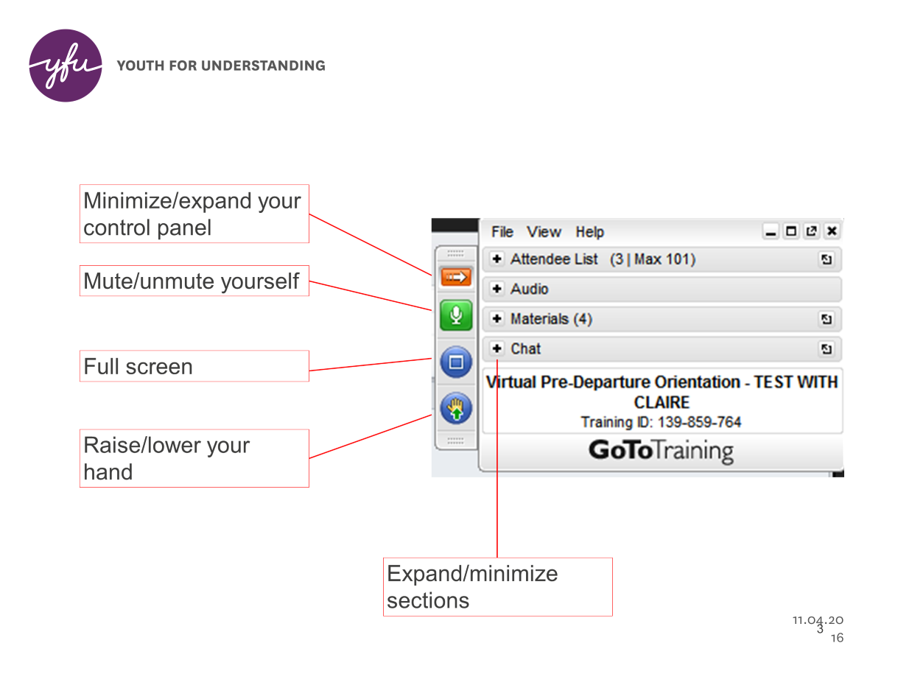
Notes:
Use the mouse to introduce the mute/unmute button, chat and raise hand feature. Encourage people to engage and ask questions.
Determine by size of your group if you want to have them muted, then unmute to ask questions or leave them unmuted, and share that with the group so people know how to ask questions on the call.
You will also need some paper and a pen for some of the activities

Slide 3
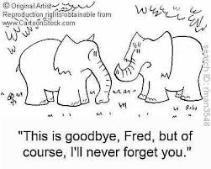
Agenda
Welcome
The New Me
Leaving the US
The Goodbye Plan
Wrap Up
Notes:
Ask a student to quickly go through the agenda for the webinar. Ask the students what kinds of things they think will be discussed during the webinar (use chat box). Ask about the significance of the cartoon.
Elephants are known to be highly intelligent and feel emotions, like humans do. And they are known for having amazing memories, especially associated with their "families" and friends.

Slide 4
Objectives:
Notes:
Ask a student to read aloud the objectives on this slide and answer any questions students may have. Ask students to provide some examples of what these objectives will cover. Fill in gaps.
- skills like resiliency, communication, dealing with challenges, adaptation strategies. Many students deepen their English speaking, writing and reading skills, cultural competencies, understanding first-hand US culture versus stereotypes
- saying goodbye is difficult for everyone- families, students, siblings friends. People deal with pain of saying goodbye in many different ways.
- logistics for departure- what to pack, etc. Also, many details that need attention- school records, bills, etc.
-re-entry can be hard for many reasons- reconnecting with friends and family etc. You can use the strategies you learned while on program to help you readjust to your home community.

Slide 5

Amelie’s Letter
Notes:
Introduce Amelie's letter to the students:
Throughout this orientation, Amelie’s letter will be read and discussed. This letter is from a 2013-2014 German YFU student and it outlines some of the key themes relating to saying goodbye to American friends and family and returning to one’s home country

Slide 6
Amelie’s Letter
Dear Exchange Friends,
When I was about to leave my home country to come to the States, I wasn't really scared. Sure, I was pretty excited and maybe a bit nervous, but never scared. But, when I had to leave my new found home-country, the US, I was scared out of my mind.
When I was leaving the US, I was freaked out with everything changing: me having to leave, having to decide which things I was gonna take with me, and how to say goodbye to certain people, friends, places and habits. You may not be experiencing the same thing. I remember hearing about situations and problems related to leaving, but, I was like "Well, no, I don't really think I am going through anything like that," and I hope you aren't going through any huge problems right now or when you arrive home; but realize that it will probably happen.
Notes:
Following are excerpts from Amelie’s letter….throughout this webinar, the letter will be read in it’s entirety.
Ask students to volunteer to read the parts of Amelie’s letter aloud to the group on the call, giving some emphasis to the bolded phrases of her letter. Encourage comments/discussion after each reading throughout the webinar. Use the chat box or ask for volunteers to respond to questions (or develop your own):
Are you surprised that she is scared about going home, why or why not?
Why is this an emotional time?
What kinds of "problems or situations" do you think she is referring to?
At the end she says, "that it will probably happen..." What will happen? Do you think this will happen to you- why or why not?
What do you think will be the biggest challenge with readjustment?

Slide 7
The New Me
Do you feel like a different person now than who you were when you arrived in America?
How have you changed?
Notes:
Ask students to think about this and respond in chat box.
This is intended to be a quick discussion to help students think about all they have accomplished during their exchange.
Explain that the next activity will require that they think and celebrate all the ways that they have changed and grown while on exchange.
Facilitator Note: During the New Me activity (next slide), the students will be thinking about their experiences and how they have changed and grown.
The New Me activity will help students articulate their new Personal Culture. Explain that it is likely that their Personal Culture/Individual Culture has changed as a result of their experiences living in another culture. Remind students that Personal Culture is made of one’s values, beliefs, attitudes, personality, and how one approaches the world. Use the iceberg graphic on the next slide and review the analogy of cultural behaviors as those above the water, whereas values and beliefs are below the water and often cannot be seen.

Slide 8
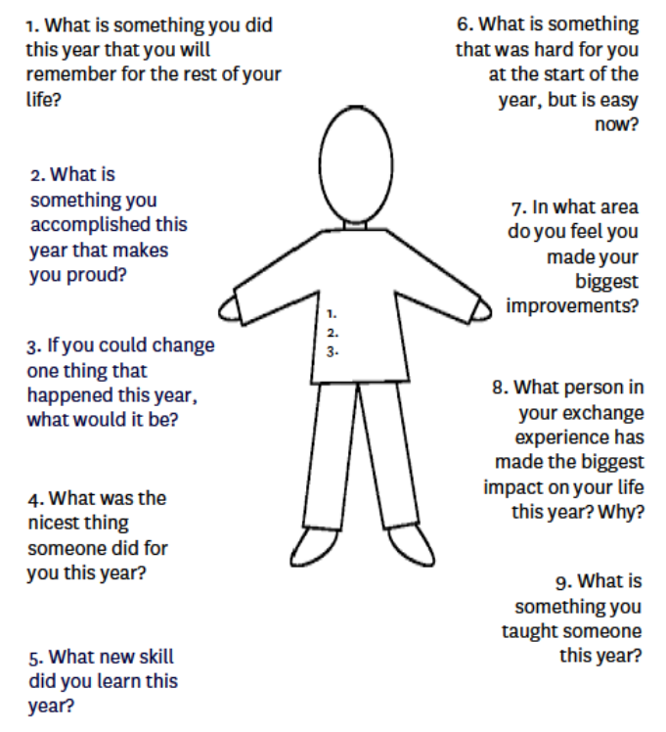
Notes:
Let’s take a few minutes to figure out who you have become. Have a student read through the questions on this slide.
Let’s do question # 1 together to get you started!
Ask the students to choose at least three questions and write their response in the chat box. They should provide the question number with the response. Provide at least two minutes.
After the two minutes, read through some of the responses and ask individuals to share, use additional follow up questions:
Conversation starters- (If conversation does not easily flow, ask questions below):
What key experiences helped develop your New Me?
What were your favorite experiences or accomplishments?
What were the most difficult experiences? Did these help you grow? How and why?
Ask students what words they came up with to describe or represent their New Me?
Remember many of the skills you learned as an exchange student are going to serve you when you return. What are some of these skills? (Patience, ability to solve problems, communication skills, ability to meet new people and make friends, interest in many more things than before, etc.)

Slide 9
Amelie’s letter continues…
Also, when you left your first home country you had a certain personality and now that you are about to leave the States you realize you have changed a lot. You may not feel it now or the first days after your re-entry, but you will notice as soon as you see yourself changing back to the old you. Don't get this wrong: you won't change back completely but you definitely have to find a balance. That was something I was really worried about too. I liked my new me and I didn't want to go back in time again to the old me.
Notes:
Ask students to volunteer to read this next paragraph of Amelie’s letter aloud to the group, giving some emphasis to the bolded phrases of her letter. Encourage comments/discussion
Conversation starter: What stage of Re Entry does this paragraph illustrate? (Adjustment)

Slide 10

Leaving the US –
What are you worried about?
Notes:
Conversation Starter: Ask the students if they remember what particular things Amelie is worried about.
Possible responses include: leaving, packing, how to say goodbye, going back to her German friends and family, forgetting her experiences, keeping up with friends and family from the US, losing her New Me, not fitting in (there are many more possibilities).
Ask the students to use the chat box to share a specific thing that they are worried about when they return home. Review some of the responses noting commonalities, and ask a participant or tow to three if you can share their challenge with the group. What advice can the group come up with for each problem.
Through the discussion remind students about all of the skills they have developed while on program such as: problem solving, active listening, being resilient, looking at challenges and differences with an open mind, learning by observing. Etc. Try to connect these skills and others to help the students solves some of the things they are worried about .
ALSO- note that not everything can be solved and it is natural to be worried about going home.
In some cases, students may be returning to really difficult circumstances (divorce, death or illness in the family, political strife). If a student shares something like this, be sure to contact the SSM and FD sothat YFU can try to help.

Slide 11

Adjustment at Home
Notes:
Ask a student to explain the graphic. (vertical shows emotions and horizontal represents time)
Remind students that everyone adjusts differently, and this is simple graphic to show the different phases of adjustment
Students will be familiar with the red portion, but the blue portion maybe a surprise. Explain how when they return home there will be more adjustments.
Ask a student to read number 6, 7, 8 and 9

Slide 12
Stages of Re-Entry
Honeymoon
Reverse Culture Shock
Readjustment
Integration and Reflection
Notes:
Share these 4 stages and encourage a student to read these. The next 4 slides of the stages of re entry will be source of discussion amongst the students.

Slide 13

Stage 1 - The Honeymoon
Notes:
Quickly remind students about the honeymoon stage. Ask students to share a few things that may happen when they first arrive home. Encourage them to think about how their first week might go and what they might do.
Additional information: Similar to when you first arrived in America, upon return to your home country you may experience a “honeymoon” phase characterized primarily by positive feelings and excitement about being back home
This temporary shift in perspective may also cause you to be surprised by things that were once so familiar to you; the room where you sleep, the corner market, the smell of the air, the traffic, or lack thereof, in the streets, etc.

Slide 14
Amelie’s letter continues…
What I also spent a lot of time thinking about was returning back to my German school and how to actualize and share my experiences with others so I wouldn't lose them or forget. How do you explain such amazing experiences? There were a couple other fears, but all in all, they are all summed up in me being scared of not feeling home in my own home country and not being able to re-adapt to the culture and people I had grown up with. I always like to describe this feeling with "a key suddenly not fitting back to its lock anymore".
Notes:
Ask students to volunteer to read this next paragraph of Amelie’s letter aloud to the group, giving some emphasis to the bolded phrases of her letter. Encourage comments/discussion.
Which stage is represented by the last phrase bolded above? ( Reverse Culture shock)
Explain the Re Entry stage of Reverse Culture Shock, if they did not make the connection between the key not fitting the lock representing Reverse Culture Shock.

Slide 15

Stage 2 - Reverse Culture Shock
Notes:
Ask students about their expectations of reverse-culture shock. Ask students how they handled culture shock during their exchange year.
In this stage the “honeymoon” is over and you experience a let-down. You may feel frustrated, alone, and/or like an outsider or a foreigner in your own country.
You may also find yourself irritated with others for no apparent reason and frustrated at not being able to express yourself in your language as well as you would like.
In this stage the “honeymoon” is over and you experience a let-down. You may feel frustrated, alone, and/or like an outsider or a foreigner in your own country. You may also find yourself irritated with others for no apparent reason and frustrated at not being able to express yourself in your language as well as you would like. You probably feel “homesick” for America, disoriented and maybe even resentful about the fact that you are back home. Your home country will be different from how you remembered it. You may also find that many of your friends and family members have lost interest in hearing about your time overseas and you will really feel the need to connect with others who can relate to what you are going through.

Slide 16
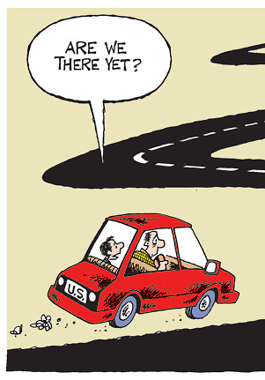
Stage 3 – Readjustment
Notes:
Ask students what will help them readjust?
- patterns- going to school, going to sports practice
- reconnecting with friends and hearing about their activities over the year
- Setting new goals
- Thinking about how the exchange year has helped you grow
- Continue to pursue new interest that were developed while on exchange
Bring up the Practical Tips for Re- Adjustment handout- (on Re- Entry website) ask student to take a look and choose a strategy that they will try
This stage is characterized by a gradual re-adjustment to life at home.
You begin to fall into familiar or new routines which provide rhythm to your daily life.
Less and less about life “back home” surprises, angers or frustrates you. Any self-imposed isolation subsides and you can more easily express yourself in your native language. You begin to fall into familiar or new routines which provide rhythm to your daily life.

Slide 17

Stage 4 – Integration
Notes:
Ask students:
What is meant by integration?
What is being integrated?
The New YOU is integrating into your home country- this is exciting!
We also hope at this stage you will recognize the many ways in which you have grown as a result of your experience and actively seek out ways to use the knowledge, skills and attitudes that you gained in the process.At this point you will have found your place, so to speak, back home. You will have established or reestablished relationships with a circle of people with whom you feel comfortable and have a more balanced perspective on both life in your home country and in America. You may find that your behaviors, beliefs, attitudes and values have shifted a little or a lot as a result of your cross-cultural encounter. We also hope at this stage you will recognize the many ways in which you have grown as a result of your experience and actively seek out ways to use the knowledge, skills and attitudes that you gained in the process.

Slide 18
Amelie’s letter concludes…
So, now a year later, after exchange, I think I never will stop being homesick because I have two homes now and I can't be both places at the same time. But I have my own second home, in the US, so I think that was totally worth it! My advice to get through your first year back in your home country: Don’t take everything back in the US for granted, and don't think back about the things you could have done. We all have experienced something great and I don't ever want to forget it. To me, it still sometimes feels like my time in the US was a dream. But I have figured out that I need to use what I have learned, appreciate what I was allowed to experience and combine my two lives (my American me and my German me).
Good luck! Amelie
Notes:
Ask students to read silently to themselves.
Ask a few students to share they connect with in this section and why.
Points to emphasize:
You do have a second home in the US- keep in touch with family, friends and YFU- you are always welcome and you are part of the YFU community- stay involved with YFU in your home country.
Combine your New Me with your past personality- be proud, you have learned so much and can contribute to the world as a global citizen

Slide 19
The Goodbye Plan
Notes:
Have the students read through the Tips for a Positive Goodbye.
Ask:
Why do we need to think about our host families?
What can you do to show your host family that you appreciate all they have done?
Is anyone planning anything special to show their host family thanks?
Why do you need to think about the balance between family and friends?
What are some of the loose ends that you will need to take care of?

Slide 20
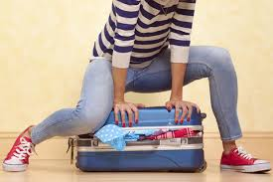
Saying Goodbye.........
Notes:
Ask student to use the chatbox to list some of things then need to do to get ready for departure in regards to logistics
-do you know your departure date? did you read the email from YFU travel that has this information? You may not get the info of times and airlines until three weeks before departure. But you should know the date of departure.
find out about airline weight limits
- figure out what to pack- should you leave some things in the US (extra clothes can be donated)
Do you need to ships some items in advance, or are you prepared to pay for additional luggage?

Slide 21
Packing and Departure
YFU Travel Phone Number
1-800-705-9510
Keep this number in your pocket
on your day of departure!
Notes:
Thank the students for joining the Re Entry orientation webinar. Encourage the students to celebrate their and their families’ accomplishments in the journey from visiting to belonging.
Ask if they have any questions
Note: If within 3 weeks of students departure, take names of any students who have not received travel information (flight info) and send this info to travel once the webinar ends.
Close the webinar by reviewing the objectives and then reading Ruby’s poem.

Slide 22
Objectives for this orientation
Notes:
Have students review the objectives on this slide and answer any questions students may have.

