Slide 1
Compliance Webinar Overview for Volunteers to Support YFU Students and Families
Notes:
Welcome participants to the webinar.
Introduce yourself and highlight how the gototraining functions work- chat box, muting oneself, etc.
Ask participants to introduce themselves (if there are less than 10). If there are more than ten, they can use the chat box to share their names and where they are from.
Explain that this training lasts about 50 minutes.

Slide 2
Objectives for Webinar
Volunteers will be able to:
Identify compliance requirements for student and host family support
Describe the volunteer actions associated with the requirements
Placement and student moves
Orientations
Area Rep Requirements
Notes:
Ask a participant to read the objectives. Fill in gaps and provide personal examples and context (or use the ideas below) so participants connect with the objectives.
Example: There are many regulations about families and placement to ensure that students and families are safe- we will talk about some of these; our global partners want to be sure that their international students are participating in high quality orientations, thus there are compliance requirements related to orientations; ARs provide oversight to families and students, the reports that they complete are critical for YFU compliance.

Slide 3
Limitations
Overview for volunteers, not all inclusive
Host Family Placement- not ALL regulations are covered, always ask FD for guidance
Volunteering - compliance requirements to become a volunteer
Questions on status: volunteerprograms@yfu.org
Notes:
Emphasize that the training does not cover everything and that the training is an overview and is designed to provide compliance information related to specific volunteer tasks and the corresponding volunteer actions. This training does NOT cover all the regulations, especially as many of these regulations are related to YFU staff responsibilities.
Host Family Placement- not ALL regulations are covered. Always talk with your FD when assisting with Host Family placement. They will direct you on specific rules related to geography, school rules, and other “local info”
Volunteering - There are compliance requirements to become a volunteer. This training does not focus on these as you should have already fulfilled these requirements. If you are unsure on your status as a volunteer contact volunteer programs.

Slide 4
Why does compliance matter?
High quality, safe programming.
Three regulatory resources:
YFU Basic Standards
YFU USA partners with YFU partners worldwide
US Department of State J-1 visa regulations (Regs)
YFU is a Designated J-1 sponsor
CSIET - Council on Standards for International Educational Travel
US schools require CSIET J-1 listing
Notes:
High quality, safe programming is our goal.
Ask participants if they are familiar and what they know about the three regulatory sources.
The three regulatory sources largely mirror each other with some higher standards from the YFU community.
Lets review briefly each one:
YFU Basic Standards- developed by international partners. YFU USA commits to carrying these out with our global partners
US Dept of State- Students come on program with J-1 visas and we are a J-1 sponsor; thus we must abide by regulations and follow related requirements around J-1 visas for secondary school programs. Other J-1 visas with parallel regulations offer opportunities for au pairs, young adults on work/travel programs, visiting scholars/physicians to come to the US.
CSIET- is the US accrediting organization for exchange programs. Many schools only accept students from organizations who are “listed” with CSIET – “listed” is the term used for accreditation by CSIET.
This training will focus on J-1 regs (as they relate to volunteer actions) and highlight the YFU higher standards. If YFU meets J-1 regs, we are in good standing with CSIET.
This is a good time to mention the J-1 vs F-1 distinctions.
98% of YFU in-bound program students are in the DoS J-1 visa Exchange Visitor Secondary School Program- the J-1 visa is for a cultural exchange (very different from a work visa, a student visa or a marriage visa).
For J-1 visas, a cultural exchange, the sponsoring organization - YFU - is the responsible party. J-1 is limited to one academic year (or semester); schools are not required to issue a diploma or offer specific coursework. The US Department of State oversees and regulates this program to ensure safe, successful exchange programs.
YFU also has program options for students on F-1 visa. The F-1 visa is for an academic exchange; the school is the responsible party for the student. US Department of Homeland Security oversees this program. This program allows for a little more flexibility with schools and placements. Traditionally F-1 was used for college programs, but more students are enrolling in high school with an F-1 program. Homeland Security does not regulate F-1 high school programs in the same manner as J-1 regarding safety for minors. Therefore YFU applies its own Basic Standards to YFU F-1 placements. This means YFU F-1 programs largely meet J-1 regs and exceed F-1 regs. One example of a different is a direct placement with relatives. This is permitted for F-1 but not J-1; YFU does allow this.
At this time, Homeland Security monitors schools and not organizations such as YFU for compliance on F-1 Regulations. CSIET does monitor exchange organizations for F-1 standards and YFU will likely apply for this listing as YFU’s F-1 population grows.

Slide 5
Golden Rule for Compliance
“If it isn’t signed and dated,
it didn’t happen…”
Quote source?
Notes:
Dept of State Compliance Department for exchanges is the quote source: if it isn’t signed and dates, it didn’t happen
This is fundamental to all of our compliance work.
This shows up as: incident reports, Monthly Contact Reports, sign-in sheets at orientations, volunteer training sign-in sheets, reports pulled for the Department of state.

Slide 6
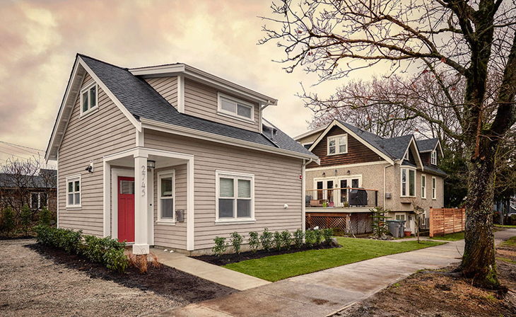
Host Family Placement
Host Family must be fully vetted
Application
Background check
Personal References
Photos of the home
Interview
HF Pre-Arrival Orientation
Notes:
Explain:
YFU is audited by the State Department and the results impact our CSIET listing certification and status as a J-1 sponsor. In addition DOS can reduce YFU USA J-1 student numbers when we are not meeting all the compliance requirements. Host Family Placement includes many compliance requirements as this is directly linked to student and family safety.
A HF must be fully vetted- this includes several steps (review steps). A student cannot move to a family if the family is not fully vetted. There are critical compliance requirements around all of these steps to being fully vetted.
Volunteers encounter questions from families about when they can see photos of students, the reference checks for non-traditional families, and YFU needs volunteer support when families must participate in a pre-arrival orientation. Let’s take a closer look at these items. We will talk about these in the next slides.

Slide 7
Regulations and Volunteer Actions
To see photos of IS, a family must be fully vetted, including pass the Criminal Background Check (CBC)
Remind/help family to complete CBC prompts within the application
Single adult families without other family members are required to submit additional references
Remind/help family to complete the references portion of the application
HF Pre- Arrival Orientation is required for ALL families. This should occur AFTER the family is fully vetted and BEFORE the student arrives in their home.
Direct family to the online course, especially new, Replacement families
Notes:
Go through each “rule” and explain the volunteer role.
Families consisting of one single adult without other family members full time who are school aged or older in the home are asked for additional references. The intent is to confirm the host parent is engaged with his/her community and the student is not at risk for being in an isolating household. This is a Department of State requirement.
Note that is many cases, YFU staff and volunteers organize in-person Pre- Arrival Orientations and these are the best option. The LMS options allows flexibility and is handy when families are vetted after the scheduled live event has occurred.
What if it is an emergency move? Answer: We will talk about that in a few more slides. There is some wiggle room for emergencies when the situation can impact student and host family safety.
Can an AR provide a one-on-one orientation? Yes, there are specific forms for this. The LMS course is the most efficient approach and is highly recommended, however, a one-on-one is a suitable approach.
.

Slide 8
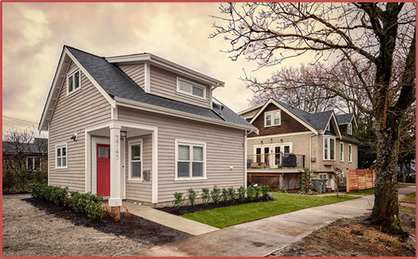
Student Moves- Temporary (6 days or fewer)
Situation | Regulation | Volunteer Action
Host parents are traveling w/o student; student stays in the home with another trusted adult | Adult must be over the age of 25 Host family adds the adult to their HF application as an additional person in the home New adult in household completes a CBC If the AR is the designated adult, a new AR is assigned by the FD | Regularly ask families about upcoming travel. Talk with family and make sure they add the adult to their HF application
Notes:
In some cases, the HF might be
Unexpectedly called away for a family emergency
Taking whole family on vacation without the student
Leaving kids behind while parents are away
This would lead to a temporary move (six or fewer days)
Different compliance requirements for different situations. Two common situations that have different requirements:
Student remains in the HF house- With an adult that is not part of the host family. For example, a neighbor or trusted family friend comes to the host family’s home
Compliance requirement: HF adds adult to their own HF application and completes a CBC. Make sure that the family does in a timely manner.
If the AR is the interim adult– another AR must be assigned for this period by the FD.
ARs should regularly ask families about any travel plans to make sure that families are making the necessary arrangements as needed.
Common questions from other volunteers:
What if the student is staying the night at a friend’s house for several days over spring break while the host parent travel. Answer: We will come to that situation is a bit. But related to this is the travel policy regarding “trips” versus moves. Moving is when the student is moving and not coming back to the original host family. Students can go on trips with other adults, pending specific rules about travel.
Potential question: Will the adult go through a background check?

Slide 9
Student Moves- Temporary (6 days or fewer)
Situation | Regulation | Volunteer Action
Student temporarily moves outside the HF home | Inform YFU (FD or SSM) Interim HF needs to complete a HF application to provide YFU household info If the AR is the interim host parent, a new AR is assigned by the FD | Regularly ask families about upcoming travel. Confirm with the HF that YFU staff have been informed. Talk with HF and Interim Family to ensure that the Interim Family completes the HF application.
Notes:
Second solution if the family will be away and the student is staying with a different family (six days or fewer): the host family designates another family as an interim family and the student stays in a different home (for six days or fewer). In this case, the HF is using their parental authority to say that this family is a safe family for the student to stay with. The HF needs to contact the FD and explain this and provide name of the interim family. The interim family needs to fill out HF application so YFU has all of their information in the case of an emergency.
The interim family DOES NOT need to be fully vetted (CBC, interview, etc.) because the HF (as the parental figure) is designating the interim family as safe. The key here is that YFU knows (via the completion of the application) where the student is staying.
If the student moves to the AR’s home, another AR must be assigned for this period by the FD. ARs should regularly ask families about any travel plans to make sure that families are making the necessary arrangements as needed.
Provide your own example of this process (or use this one). Sandra and Mike are hosting Simone. They are going away for their anniversary for four nights. Their neighbors, Cecilia and Joe, are reliable and the families are close friends. After the neighbors agree to be an Interim Family, Sandra tells the local FD and her AR about the travel plans. Sandra asks Cecilia to complete a HF application so that YFU has their contact information. A week prior to the trip, the AR checks in with Sandra to confirm that the neighbors completed the application and reaches out to Cecilia and Joe to introduce herself and explain that if they need any assistance, she is there to help. If the neighbors have not completed the application, alert the FD for additional assistance.

Slide 10
Student Moves- 7 or more days
Similar rules and volunteer actions EXCEPT the new family must be FULLY VETTED
YFU leads the vetting process
Possible volunteer actions: help the family with the application, do an HF interview, and lead a PAO
YFU staff designates the new family as a “replacement family” in the database
Replacement Families are included in DoS reports from YFU
Notes:
HF might be
Unexpectedly called away for a family emergency extending more than seven days.
A trip and the student is not coming with the host parents
Temporary HF may be identified by:
Student
Host family
YFU USA
If the temp family is the students’ AR – another AR must be assigned for this period.
Compliance requirements for temporary Host Family
must be
Fully vetted YFU Host Family
Entered as a placement in my.yfu
Requires app, clear CBCs, photos, interview, references
If the temp family is the students’ AR – another AR must be assigned for this period.

Slide 11
Emergency Moves “student must be out today.”
Student safety guides the process
Very sensitive cases- YFU staff leads this work
Volunteer Action
Help the FD by:
Identifying a suitable new family
Assisting the new family to be fully vetted (HF application and interview) and
Direct family to the HF Pre- Arrival Orientation
Notes:
In some cases the emergency is extreme and the move will take place while the new family’s vetting is in process in order to keep the student safe. This is a YFU staff decision and not the responsibility of the volunteer.
In the case of emergency moves always ask the FD for guidance on how to support the process. Many times these are sensitive cases that require extreme care. Volunteer actions include: helping the FD find a suitable family that will meet the requirements, helping to fully vet the family as quickly as possible- doing the interview, helping the family complete the application, directing the family to take the online Pre- Arrival Orientation.

Slide 12
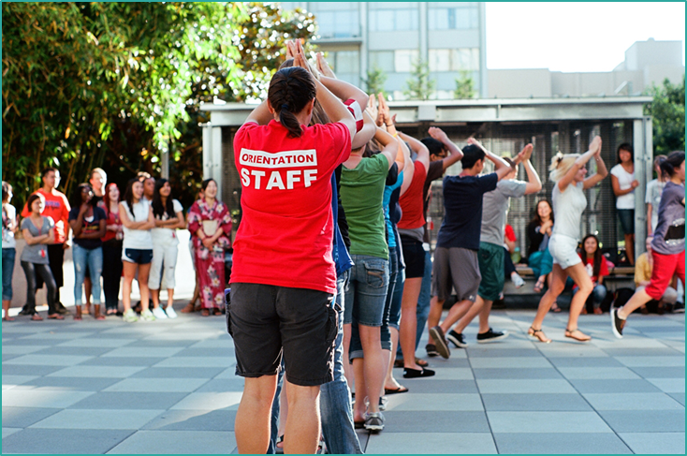
Requirements for Orientations
International Students: four orientations
Study Abroad Students: three or four orientations
Notes:
There are also requirements in regards to orientations. There are four orientations for IS students and families. And three or four orientations for SA students.

Slide 13
YFU Orientations for IS
Host Family Pre-Arrival Orientation
(DoS, YFU Basic Standards, CSIET)
Student & HF Post-Arrival Orientation
(DoS, YFU Basic Standards, CSIET)
Student Mid-Year Orientation
(YFU Basic Standards)
Student Re- Entry Orientation
(YFU Basic Standards)
Notes:
Ask participants to review the slide. Ask what they know about the different orientations and the goals of these orientations.
Ask why they think there are regulations around orientations?
Answer (expand and provide personal examples as needed): Orientations promote safety and help students and families have a meaningful exchange experience. This is directly related to high quality programming and safety (as mentioned earlier). Each orientation focuses on specific topics related to the timing of the exchange. The Pre- Arrival helps families understand their responsibilities and the resources available, as well as safety regulations. The Post Arrival has similar themes, but includes culture and helping students and families adjust to one another.
Additional info to highlight. YFU is audited by the State Department and the results impact our CSIET certification and J1 sponsor status. In addition DOS can reduce YFU USA numbers when we are not meeting all the compliance requirements. Attendance at orientations are included in these audits.
YFU partners around the globe also follow up with YFU USA on orientation attendance. Non- attendance can have negative impacts and this affects YFU USA relationships within our network
Note that it is a best practice and is recommended by YFU that host families also attend the student orientations. All families must participate in a HF Pre- Arrival.
In some fields, HF must also attend the other orientations. The Field Director will provide specific guidance to families on their attendance at the orientations. It is important to note that students and families have a more meaningful exchange year and there are fewer support cases when students and families attend the orientations together.

Slide 14
YFU Orientations for SA
Pre- Departure – Local or webinar
(YFU Basic Standards, CSIET, and DoS for CBYX)
Students going to Japan: Japan Pre-Departure Orientation (YFU USA and YFU Japan) OR
Students on semester or year program: National PDO (YFU USA and YFU Partners)
Parent Pre-Departure Orientation
(YFU Basic Standards)
Homecoming Orientation
(YFU Basic Standards)
Notes:
Ask participants to review the slide. Ask what they know about the different orientations and the goals of these orientations.
Local PDOs can be live events and students register online
Webinars are available for students who cannot attend
JPDO- for students going to Japan, typically in in June
NPDO- for students going on program for a semester or year- typically occurs in July
Parents can attend webinars and local orientation sessions for more information about their student’s program and how to support the child.
YFU goes through audits for CSIET which verifies orientation attendance for our CSIET listing certification. Attendance at orientations are included in these audits.
YFU partners around the globe also follow up with YFU USA on orientation attendance. Non- attendance can have negative impacts from YFU partners this affects YFU USA relationships within our network
Note that it is a best practice and is recommended by YFU that host families also attend the student orientations. Is some fields, this is required by the Field Director. The Field Director will provide specific guidance to families on their attendance at the orientations.

Slide 15
Volunteer Action: Sign-In Sheets
Use pre- populated sign-in sheets
Everyone signs in (facilitators & volunteers)
Submit via email to orientations@yfu.org
Timing is critical- don’t sit on sign-in sheets
Notes:
Review slide- emphasize that the sign-in sheets are used to mark attendance and records are kept at the national office to show attendance at all events. These records are pulled and scrutinized for reports and audits. It is important to pre-populate sign-in sheets with typed names so that it is clear who attended. Everyone in attendance, including facilitators and volunteers need to sign.
Timing is important and sign-in sheets needs to be submitted right away so the national office can track attendance over a given timeline.

Slide 16
Critical Requirements for the AR
Take YFU online training to fully understand these tasks
Monthly Contact Report (MCR)
Submitted online by the 25th of each month
First visit MUST be in-person; a second in-person visit during the second semester
Student Environment Evaluation (SEE)
For Arrival or Temp families: this in-home visit required within first 30 days
Permanent families: this in-home visit required within 60 days
Host family interviewer may not complete the SEE visti
Notes:
Ask participants what requirements and rules they know of in regards to the AR role. Many volunteers are AR, it is likely participants will be familiar with these ideas.
Emphasize that if a person is a AR, YFU asks that they take the online training at least once a year to refresh their skills.

Slide 17
AR MUST CONTACT YFU
Any alleged or actual violation of a sexual nature
Death
Police involvement with a student, host parent or a person in the student’s life
Any other situation or incident involving student, host family or other person close to the student that may become a negative news story.
VOLUNTEER ACTION:
Call SSM IMMEDIATELY or after-hours emergency number: 800.424.3691
Notes:
Explain that contacting the SSM is critical. The SSM will likely have many questions so that they can complete an incident report. Incident reports are submitted to the Department of State

Slide 18
Wrap Up
Volunteers will be able to:
Identify compliance requirements for student and host family support
Describe the volunteer actions associated with the requirements
Placement and student moves
Orientations
Area Rep Requirements
Notes:
Ask a participant to read the objectives. Ask participants to think about the conversation about placement: use the chat box to type at least one new requirement that they learned and one volunteer action that they can take to keep YFU compliant.
Highlight some answers, clarify as needed.
Ask them to think about the orientations discussion- use the chat box to type at least one new requirement that they learned and one volunteer action that they can take. Highlight some answers, clarify as needed.
Finally ask about the Area Rep requirements- use the chat box to type at least one new requirement that they learned and one volunteer action that they can take. Highlight some answers, clarify as needed.
Thank everyone for their participation. Let them know about any other follow up communication concerning resources and answering questions that were challenging.

