Slide 1
The First Student Visit & SEE Visits

Slide 2
Carry out the three goals of the first visit
Volunteers will be able to
Access and use YFU forms to carry out the SEE visit
Notes:
Welcome participants- ask names and locations
Ask about their experience as volunteers
Go through objectives

Slide 3
A successful 1st visit can…
Mutual Beneficial Relationship
Make repping easy and rewarding
Successful exchange and adjustment
Notes:
Highlight how a successful first visit with the student and family can impact the entire year
Successful exchange
Developing a beneficial relationship for all parties
Will help the AR to rep the student for the entire year

Slide 4
Goals of the First Visit
Establish trust
Inform student and host family of YFU policies
Explain: Importance of
communication and anticipating issues
Notes:
The goals of the First Visit:
Establish Trust and Report, start off on the right foot with the student. Encourage openness and communication.
Inform the student; discuss YFU policies and procedures, not JUST with student- review policies with host family,
Explain the importance of COMMUNICATION and anticipating issues

Slide 5
Trust: Area Representative
To be the YFU Contact person for the Family, student and school.
To be a mentor to the student and HF, this includes to be an unbiased advocate and helping to solve problems.
To be the representative of YFU in the local community and school.
Notes:
Establishing trust-
With student and family, describe the AR role and how the relationship between the AR and Student and AR and family is built on trust
Learn more about the student and family (low-pressure questions: What are you most excited for about the year? What are some of your goals for the exchange? Have you traveled a lot before? What kinds of family activities will you do this year?

Slide 6
Where to start?
Introductions
Schedule visit with HF
Be warm and encouraging
Chat in a private room
Exchange contact information
Open Ear policy
Notes:
Introductions: Once you are assigned a student, please email them or even skype them to introduce yourself. Please call the host family as well. Once you have established your role with both HF and student, schedule your first visit. This can be a visit over a meal or maybe a visit after work. This MUST take place within the first 2 weeks of the student’s arrival.
Reintroduce yourself to the student and family.
After you become acquainted, ask to speak with the student in private, perhaps the student’s room or kitchen. (You may take the student off premises, but please get the approval from HF). – Ask for ideas/suggestions
Be warm and encouraging and reiterate the importance of your role. Open up with the student. Maybe tell them a little about your history as a volunteer, your overseas experience or anything you would like to share. Ask the student about him/herself. Ask them about what they are eager to do while on exchange.
Ensure to exchange contact information. Kids love to use Whatsapp and text, this can be useful for scheduling your monthly contact but does NOT suffice for the monthly contact.
Discuss your “open ear” policy. List any unavailable times or preferences.
Make sure to let them know of any upcoming vacations/travel.

Slide 7
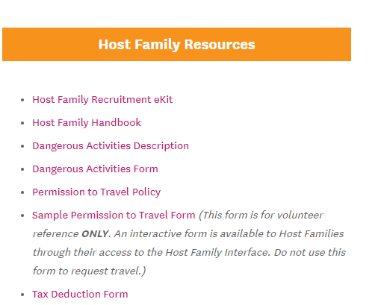
Inform Student and Family
YFU USA Policy and Procedures
Orientations
Permission to Travel
Dangerous Activities
Notes:
ARs need to keep the HF and Student informed of YFU Policies and Procedures, include PTT and Dangerous Activities. Both forms can be found on the Vol Lounge.
This is a great time to reiterate the importance of attending the orientations. Post, Mid-Year and Re-Entry. If you have the dates, please share with student and family during the first visit.

Slide 8
Communicate and Anticipate

Slide 9
Open Communication
Practice good listening skills
Use open ended questions
Encourage open communication between HF and Student
Notes:
“The first visit is a great time to practice your listening skills and open ended questions. Encourage openness and communication with both HF and Students. Often times it is due to miscommunication that great issues develop.
Ask participants- what is the difference between open-ended, leading questions, and closed questions. Ask for examples
Ask participants- why are open-ended questions a better approach to building trust? (encourage deeper, more comprehensive answers)
Try to avoid using leading questions, questions that can influence a responder.”

Slide 10
Active listening tips
Pay attention; stay focused
Keep natural eye contact
Body language
Acknowledge the speaker - nodding
Don’t interrupt
Don’t judge; listen with empathy
Repeat back/paraphrase to affirm understanding
Notes:
Active listening requires concentration and frequent acknowledgement of what is being said. More often than not, people talk at each other rather than taking time to truly hear what the other person has to say. Empathizing and trying to understand someone else’s view, even if the view is one that is not shared by the listener is what active listening is all about.
Body language- Keep body posture open and inviting. The listener should relax their body, lean slightly forward, toward the speaker and keep their arms uncrossed
1. Pay attention to the speaker and stay focused. Give the speaker undivided attention.
Eye Contact
Interestingly, psychologists have reported that some teenagers are often most comfortable opening up when they don’t look somebody in the eye. Taking a student for a drive, or going on a walk, and asking questions may help students feel less interrogated and more like they are simply engaged in a conversation.
Give the speaker undivided attention. Keep natural eye contact.
Keep body posture open and inviting. The listener should relax their body, lean slightly forward, toward the speaker and keep their arms uncrossed. This will help the other person relax and open up.
The listener’s thoughts should be focused on the conversation. Try to be present with everything the other person is saying, even visualizing what they are sharing.
Stay focused on the speaker.
Don’t mentally prepare for what to say next. First hear the person all the way through and then come up with any follow up question. This way the listener won’t miss any details.
After the speaker finishes, it is fine to take a moment to formulate any questions or ideas, rather than thinking about how to respond while they are speaking. By pausing and reflecting on what was said in order to formulate the question or idea, the speaker will appreciate that the listener truly wants to ask a meaningful question and understand their ideas.
Avoid being distracted by any environmental factors. Don’t have important conversations with a TV on, or in loud places (such as walking around a shopping center) that will have environmental distractions.
It is important to ensure that the space being used allows for a private and honest conversation. Asking a host family to leave to speak privately with the student or taking the student for a walk might be great way to do this.
Also, put away all the electronic devices and ask the student to do the same. No one should be checking a phone while having an important conversation.
2. Acknowledge the speaker by nodding or gesturing. Make sure the student or the host family knows that the AR is listening to them.
Nod occasionally
Smile and use facial expressions
Use verbal signals like “yes…umhum.”
Verbal cue- Hmmm? with the inflection going up at the end indicates a question. This is a great way to indicate that the listener needs more details.
To confirm a visualization is correct, ask, “I am picturing this……is that right?”
3. Don’t interrupt and embrace moments of silence.
Be patient and allow for moments of silence as these moments promote reflection. Even if the student speaks perfect English it might take them some time to retrieve the proper words to express themselves.
Provide time- Silence can be uncomfortable but it can be also a great invitation for others to open up.
Avoid interrupting the speaker. This can be a distraction and/or a sign of disrespect. This can cause the speaker to lose their confidence to open up.
4. Withhold judgment and listen with empathy.
Judgment can quickly stop a conversation.
The AR should be an unbiased advocate for the student and the host family, which means that the AR might be the only person in the situation who can take a step back and see what is really happening. It is not about who was right or who was wrong. It is about facilitating an open dialogue between the student and host family and helping them to communicate with one another.
The AR should put themselves in the position of the speaker as they listen. Recognize that if the student is raising concerns, he or she is at a critical point in their exchange experience. In order to comfortably and accurately share their concerns, they should feel supported by the AR and YFU.
Strategies for Active Listening
1. Pay attention to the speaker and stay focused. Put away electronic devices.
2. Acknowledge the speaker by nodding or gesturing.
3. Don’t interrupt, and embrace moments of silence for reflection.
4. Withhold judgment and listen with empathy.
5. Clarify and gather information; paraphrase to confirm details.
5. Clarify and gather more information to endure a full, deep understanding.
AR should confirm that they understood the message correctly and that they understand the most important points.
Repeat back what the student said using the same words and ask for confirmation.
Paraphrase what they said using some of these expressions “So what I heard you say was…” “What I understood from what you said was…”
Or summarize their comments and ask for confirmation that you included everything.
If visualization was the method used, the AR can say, “I am picturing this……is that right?
Ask if there is anything else to say about this? Encourage the speaker to take his/her time. This gives the speaker the chance to reflect for a moment and make sure that they are satisfied with what they have shared.
Seek clarifications while listening. When working with people from other cultures it is very easy to misinterpret what they are saying, both with their words and with their bodies. Keep in mind that things like eye contact, personal space and gestures are all part of a culture and the meanings differ from culture to culture.
Don’t be afraid to ask questions such as:
I noticed that you are not looking at me. I am curious, why is that?
What exactly do you mean by that?
Is this what you mean?

Slide 11
Anticipate challenges
Culture shock
Homesickness
“Bad” days
Notes:
Being an exchange student will be a challenge. It is important for students and families to know why you are here for them.
Things will not be the same as they are in their natural country. School, home life and more may be incredibly different than with their natural family.
Provide tools and tips on how to deal with homesickness and overall tough days. – ARs can find these tools and tips in my.yfu.org in the volunteer lounge and in orientation materials.

Slide 12
Tips for Student Success
Memory Jar / Journal
Keep active
Limit social media
Try new things
Other ideas?
Notes:
Memory Jar/Box- This idea came from one of our volunteers. Give the student a small box or jar. Each day, ask student to place an item or note that reminds them of one good thing that happened that day. (A on quiz, tickets to movie, photo from school) When student has a bad day, remind them of the good things and have them look through their jar. It will put things into perspective, things get better. This one day will not overshadow all the good ones.
Keep Active- when you stay busy, you do not have as much time to think about how sad you may be. Encourage the students to try new things, join clubs and go out for sports.
Limit social media/communication with natural family. This is a tough one due to technology, but just remind them they cannot be tied to their phone and also fully embrace exchange.
Other ideas/thoughts?

Slide 13
SEE VISIT
Student Environment Evaluation

Slide 14
What is it?
Student Environment Evaluation (SEE)
Confirm house remains safe environment for student
Required by the US Department of State
Must be done within 30 days (for arrival families) or 60 days (for permanent families) of student’s arrival
Cannot be conducted by interviewer and may be completed by a neighbor or friend
Notes:
SEE_ Secondary Environmental Evaluation
The SEE visit is part of YFU’s support structure which is based on checks and balances, with the primary purpose
being to observe how the family has accommodated the student and to ensure there have been no changes in the safe environment since the interview.
The SEE Visit is required by the DOS.
The SEE visits are assigned in my.yfu and the evaluator will be notified via email. Must be completed within 30 days for arrival families, and 60 days for permanent families.
Person who did the interview cannot do the SEE visit
However, the person does not need to be a vetted YFU volunteer. For those placements without a YFU volunteer available, a neighbor or friend may complete the SEE visit. Once this person has been identified, provide the first and last name and the zipcode of the person willing to do this to the field director, and the person may then be entered in my.yfu.org as a “Friend of YFU”. Once the visit is assigned to this person in my.yfu.org, they will receive an email with basic instructions and a copy of the SEE visit form. This person will then need to print off a copy of the SEE visit form, complete and sign it and then fax the form to the Regional office using the number listed on the form, or submit a paper copy of the form to the field director to upload to my.yfu.org.
Neither student nor entire family needs to be there (but can be there), as this visit is a check of the students’ environment

Slide 15
SEE Visit Checklist
Ensure home maintains safe conditions
Tour the home, including outdoor space
Student’s bedroom
Student’s bathroom; running water
Phone access

Slide 16
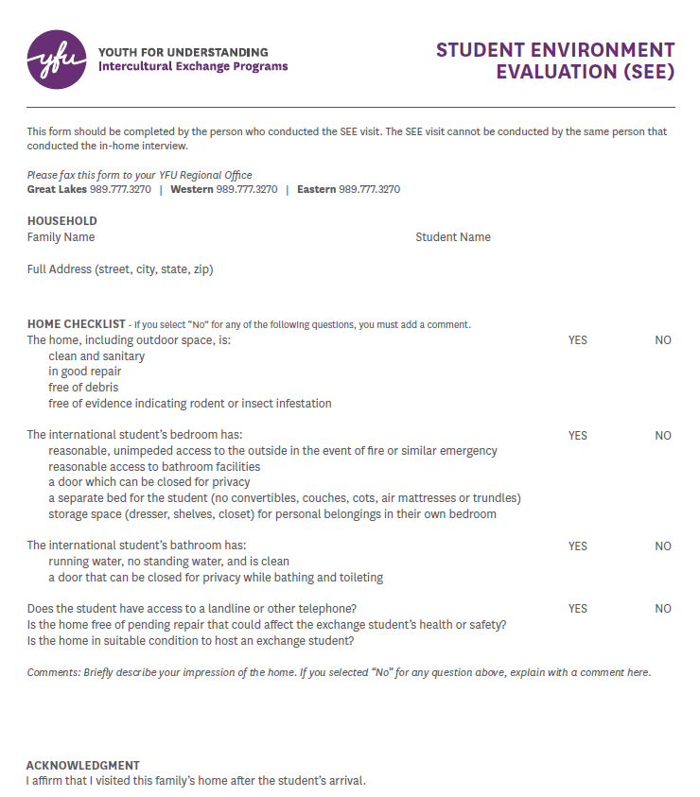
Notes:
For the person conducting the visit without access to my.yfu, this is a copy of the form. Go through some of the questions.
Complete form and fax to YFU Regional Offices. Numbers can be found on the form. Or snail mail or upload to my.yfu
The next slides will cover accessing the report and how to submit it electronically

Slide 17
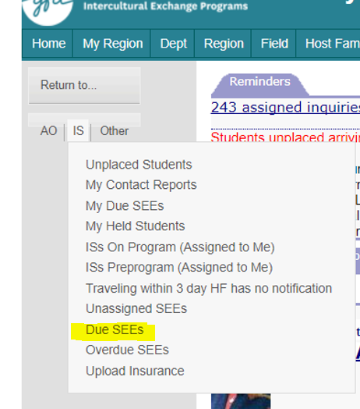
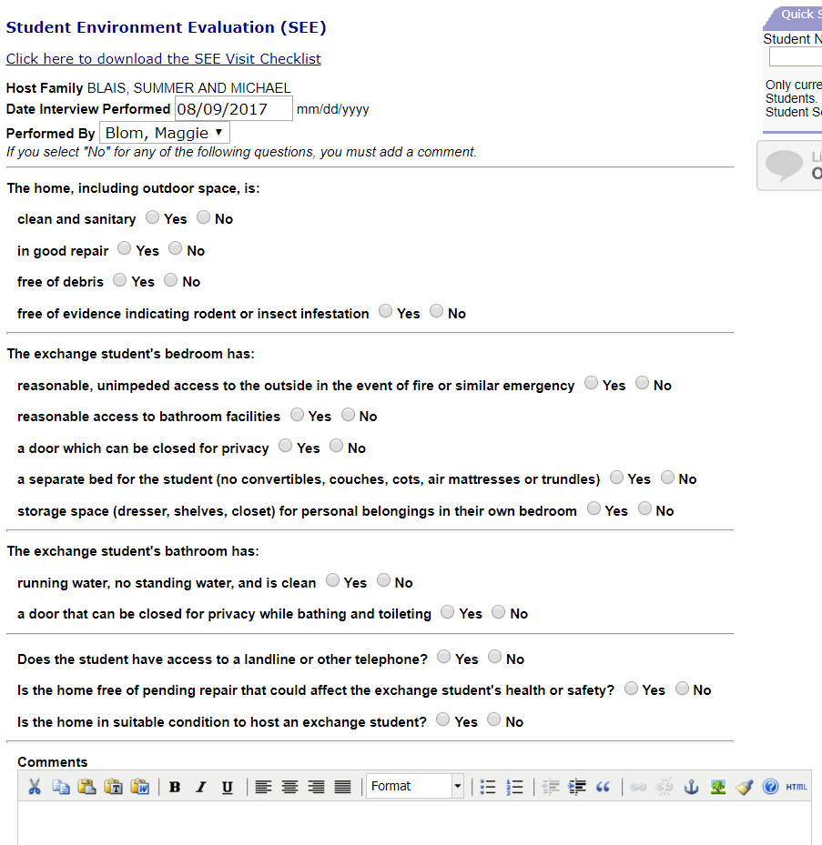
Notes:
You will be alerted via email if you are requested to do a SEE visit
The email will have some instructions and a deadline
You will want to print a copy of the form to guide your visit in the home
To access online copy. Log into account on my.yfu, hover over “IS” on left side panel, select “Due SEEs” as shown on the left side of this slide.
Print form and take with to the visit to use a check-list.
After completing the visit, log back in to complete the form, sign and submit.
you will need your E-signature to sign.
GO LIVE and Take the participants through the process of accessing the SEE Visit Form online and show the number of ways they can submit form.

Slide 18
Carry out the three goals of the first visit
Volunteers will be able to
Access and use YFU forms to carry out the SEE visit

Slide 19
Wrap Up
Additional questions
Volunteer Programs: volunteerprograms@yfu.org
Additional Resources: SEE Visit Explanation and Requirements
Notes:
Go live and show volunteer lounge where they can access the SEE handbook

