Slide 1
Host Family Interview Training
Notes:
Have gototraining up and running and the title screen for 15 minutes in advance of the training start time.
A few minutes prior to start time chit-chat with participants and make sure technology is working for everyone
Remind people that if they are in a noisy location that all the participants can hear the background noise- TV, someone loading the dishwasher, pets and crying toddlers.
If there is a large group on the call it may be best to mute everyone and focus on people using the “raise your hand” function in order to participate.
NOTE for trainer- within this training anything in BOLD is a regulation and as the trainer, you need to be aware and make sure to emphasize this rule.

Slide 2
Minimize/expand your control panel
Mute/unmute yourself
Full screen
Raise/lower your hand
Expand/minimize sections
Notes:
Take a moment to introduce the mute/unmute button, chat and raise hand feature.
Click on Attendee List to see other participants; click on Audio to see who is speaking.

Slide 3
Welcome & Thank You
Host Family interviewing = critical need
Great task for volunteers; people oriented
Be ready to share your YFU stories
Notes:
Meet and greet your audience:
Welcome everyone and thank them for coming, introduce yourself
2. Go over names and where people are from (depending on the size of the group).
3. Have a conversation (ask volunteers for their thoughts and experiences with host family interviews, take note of who on the call is very experienced) about the bullet points to provide context about the training:
Explain why HF interviewing is critical to YFU- YFU needs host families every year (especially new families) and the vetting process requires an in-person interview. This is a very valuable contribution to YFU.
Fun task for volunteers, it’s people orientated and it is about building relationships with families
You get to share your YFU stories (keep it positive)

Slide 4
Training Objectives
Volunteers will be able to:
Identify the three stages of the HF interview and explain the key responsibilities for each stage
Find the interviewing resources
Follow DOS and YFU regulations during the interview
Use successful interviewing techniques
Make a recommendation based on observations
Complete and submit interview form
Reminder from the experts
The HF interview contributes to:
building relationships
setting HF expectations
preparing for student placement
Notes:
Ask a participant to read the objectives, with each objective provide some examples or additional context to make the objective come to life, use the phrase “Volunteers will be able to”
Ask if anyone has any questions about the objectives.
Addition idea/reminders to discuss: The host family interview is one of the earliest and best opportunities to begin a relationship with the host family. A good host family interview helps not only with the placement and support of our students; it also helps set realistic host family expectations and encourages host family development and positive change toward incorporating the student as a member of the family.

Slide 5
3 KEY STAGES for a successful host family interview
Schedule the interview
Prepare
Gather YFU interview tools
Before the Interview
Know your responsibilities &
obtain necessary information
Be attentive in order to submit a meaningful report
At the Interview
Submitting the Forms
Submit the HF interview report
Compliant forms maintain YFU integrity
Notes:
Present how the material will be chunked into thee stages.
Before the interview - tasks and activities for preparation
At the interview - best practices and tips to use during the interview
Submitting the forms - the process to complete the reports and submit the forms
Interview is your first chance to meet the family – try to establish a positive tone for the year.

Slide 6
Before the Interview
STEP 1
Schedule the Interview
Reminder from the experts
Everyone who lives in the home must be present*
Note the HF communications preferences
Notes:
Step 1 Schedule the Interview
Go through the information using questions to encourage participation. Participants can use use the chat box to share what they know already about this process. See notes below for specific talking points.
Ask: What are some of the key steps for scheduling the interview? What do you know about scheduling the interview? What specific regulations (these are bolded below) do you need to take into consideration when scheduling the interview?
Schedule the Interview notes for trainer:
Contact the family to introduce yourself and to schedule the interview. Sometimes the FD will start this process and connect you to the family via email.
Let the family know that this is not a quick process. They need to set aside potentially two hours (depending on the size of their family)
Stress that all family members (regardless of age) who are in the home for more than 100 days during the year must be present for the interview. *If someone, such as a HS student who is living abroad, or a family member who is traveling for work for an extended amount of time cannot be present than that individual needs to send an email to the interviewer explaining why he/she is not present and their intentions in regards to hosting. The volunteer leading the interview then forwards this email to the FD for records keeping.
Explain the purpose of the interview- YFU wants to learn more about them and their hosting goals/motivations. YFU also wants to help the family figure out the best student match. Lastly, the interview also includes a tour of the home, as mandated by the US Department of State. Emphasize that this in not about judging, but it’s about safety and security.
Be sure to thank the family in advance for letting you come by to carry out this activity.
Ask the family what is a good time for them. Try to meet their schedule needs.
Tips from experts:
Rather than making all arrangements by email, have a phone call to introduce yourself, build rapport, and talk about the interview process
Before you call, you can send an email (or text) to identify yourself and say that you will be calling.
Ask whether email is an effective way to communicate. Or maybe they prefer texting.
Pay attention to how the family communicates with you- do they get back to you quickly? Are they friendly and happy that you are reaching out to them. Do they only use email or texting? If something about their communication style bothers you (for example, they don’t respond to messages within a reasonable time-frame, or they never respond) note this. This is important as YFU often needs to contact families.

Slide 7
Before the Interview
STEP 2
Prepare- Read the host family application
Log into my.yfu.org
Reminder from the experts​
Getting to know the family "on-paper" will help you have an interesting, relaxed conversation.
Notes:
STEP 2
1. Ask participants why reading the host family application is an important preparation step.
Reading the application notes for trainer:
By reading the HF application, you will get to know the family better and will have a more meaningful interview. Get to know their names and the ages and grades of the children. YFU is all about relationships and the interview is the first step. By being very familiar with the family application, you will be able to ask questions more naturally and will build the YFU connection. For example: Christine, Mom 37, profession: engineer. Christine, I read that you are engineer, do you find yourself helping with a lot of math and science homework with the kids? Tell me about your evening time after school and work?
2. Explain the steps of accessing and submitting forms. Note to facilitator- it is best to show them “live”. Click through the next three slides quickly and then bring up the interface and show them exactly how to do this.
To access the HF application, go to your home page on my.yfu.org
Click on Other; click on Host Family Interface
3. If this HF has hosted many times with YFU, the interview should take less time.

Slide 8
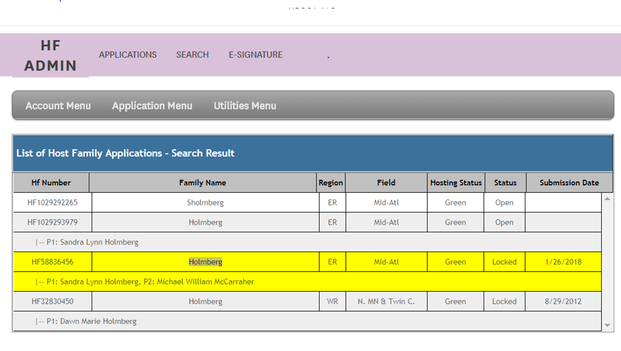
Before the Interview
►Use Control + F and type in the family name
Click to highlight family name in yellow
Notes:
Trainer- go through these slides quickly and then open the HFI and show participants in “real time”
Highlight the name of the family that you are interviewing; then click on Application Menu. (The program will prompt you to highlight the name if you do not complete this step.)
Click on Download PDF App for the family’s application.
Read your host family’s application – It took them a long time to complete the application - they will appreciate that you’ve taken the time to read through it and get to know them.
It will familiarize you with the family members and give a sense of the household. Pay special attention to what the family reports that they do together and what type of community involvement they have. This will give you an idea of what their family life is like and their engagement in the community.
It provides areas where you might want to learn more information.
You will receive a handout with step-by-step instructions.
ick on family name to highlight. It will show in yellow.

Slide 9
STEP 2
More preparations…….
Where is the family in the application process?
Notes:
You can also check to see how far along the family is in the process. Ask participants why this is a good idea.
You can look at the different tabs to see what the family has completed
Identify missing requirements and ask the regional office if they have already been submitted. (Host Family Agreement, References, Criminal Background Check, photos of the home) [Volunteers cannot see the Criminal Background check]
By knowing where the family is in the process, you can also provide friendly reminders so that they can complete the application – Asking the family for information they have already provided makes you and YFU look disorganized and unprofessional.
Take hard copies of any missing documents with you to the interview. If you help the family complete them, keep in mind that this will add time to the interview.
Host Family Agreement forms are provided at www.my.yfu.org (a later slide will show the link)

Slide 10
Department of State regulations for the Host Family Interview
Prepare - know the regulations
Interview must take place in the home
Must include a tour of the home (safety inspection)
All family members must be present
Interviewer cannot conduct reference checks or SEE visit
Family orientation cannot be done at the time of the interview
Families must be completely vetted before seeing student photos
Notes:
Ask participants what they know about these regulations, ask why each regulation is important
Remind participants that DOS allows YFU to process visas for the J-1 students as part of the Exchange Visitor Program, thus YFU must follow DOS regulations.
The Department of State requires the most personal/intrusive questions. Be upfront about this and explain you are required to ask some questions that may seem awkward or difficult. Tell families that all families must answer these.
Put a positive spin on this – be proactive about making the following point: It is likely if the host family were sending their child to live in a host family, they would want the interviewer of that family to ask these questions.
In order to meet all Department of State and YFU policies, confirm when scheduling the interview..
All family members must be present. If a family member, who is 18 years or older is not present, a follow up plan must be noted. Follow-up can be by phone and /or the person can send an email to the interviewer with information about why they want to host. The interviewer then sends this to the FD.
The interview must occur in the family’s home and must include a home inspection.
Interviewer may not be the same person who conducts the reference checks and the interviewer cannot conduct the SEE visit.
While it may at times seem convenient to conduct the host family orientation at the same time as the interview, Department of State regulations DO NOT allow this. However, it is OK to introduce some pre-arrival topics like realistic expectations and YFU expectations.

Slide 11
Host Family responsibilities:
Basic needs– separate bed, suitable study area, 3 meals per day; HF decides how much $ to spend on "extras"
Guidance – emotional support; school and medical decisions
Assist with transportation
Orientations (4)
Be available for monthly contact and respond to YFU communications
Notes:
As the interviewer be sure that you know the basic requirements of hosting. Address this at the beginning of the interview. Otherwise it will be “the elephant in the room.”
Families will receive a Host Family Handbook which outlines procedures and provides helpful information for a successful exchange experience.
Financial – any outlay beyond room and board is the decision of the family
Guidance – We hope that HFs will provide emotional guidance; they are the student’s family for the exchange year. Student and natural parent agreement gives authority to make school and emergency medical decisions. (keep copy in car) – health info, make copies
Transportation – assist with reasonable transportation needs
Orientations – Assure attendance at orientations. Pre-arrival orientation is mandatory for families; students must attend Post-arrival, Midyear and Re-entry orientations. Parent sessions are provided for all orientations, and YFU strongly encourages parent participation.
Monthly contacts – monthly is the minimum. Host family cooperation is needed.

Slide 12
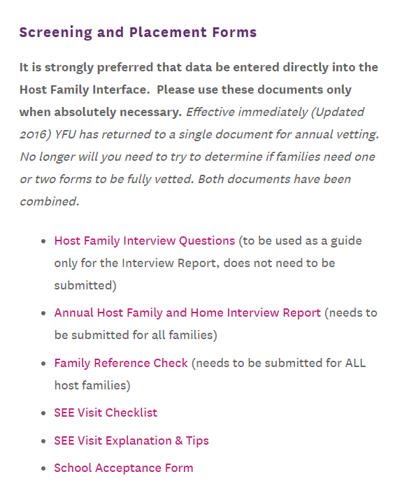
STEP 3
Gather YFU
interview tools
Notes:
Present where the interviewer finds the tools.
Emphasize that the Annual Host Family and Interview Report is what the volunteer will complete after the interview and will enter this online.
There are many other tools, including a list of questions- Host Family Interview Questions.
Trainer Notes:
Tool one: Annual Host Family and Home Interview Report- Bring a copy of the Annual Host Family Home and Interview Report. Get to know this form well. This is the form that you will complete online. Print this and take this report with you to the interview and take notes per question so you can complete and submit the report online when you get home.
Familiarizing yourself with the questions before the interview will help you get a sense of what you’re trying to learn about the family and observations you’ll need to glean from the face-to-face meeting.
The online report which you will complete is actually asking your opinion of the family based on the discussion (or interview) and in many cases asks you to make judgement call such as: Do you feel the family’s home is situated in a safe neighborhood. If not, please explain. Study the reporting form, think in advance about the kinds of questions you can ask the family to help you answer these questions.
A second form is also helpful- Take a look at the Host Family Interview Questions- these are examples of questions you can ask to help you get the info you need to complete the report.
Reviewing and becoming familiar with these documents before you meet with the family will give you confidence and a level of comfort with asking the questions. Familiarity will allow you to guide the conversation and take notes at the same time.

Slide 13
Host Family Interview Report
Online report submitted after interview
VS.
Suggested questions that one can use to talk with the family: HF Interview Questions
Notes:
Click: https://static1.squarespace.com/static/56167d1de4b0141a0f9a9378/t/58ef9e9220099e952ff4b1fd/1492098706398/AnnualFamilyHomeReview.pdf
to show the actual report and explain the difference between the report that they will be submitting online and the additional questions that will provide examples of questions one can ask.
HFI Report: skim through the report and ask participant for comments on some of the questions.
Note question 14- warning indicators, explain that this will be discussed later.
Note question 16- the interviewer will check off certain traits that they observed. Remind the volunteers of the sample questions which can help them develop their responses on what to tick.

Slide 14
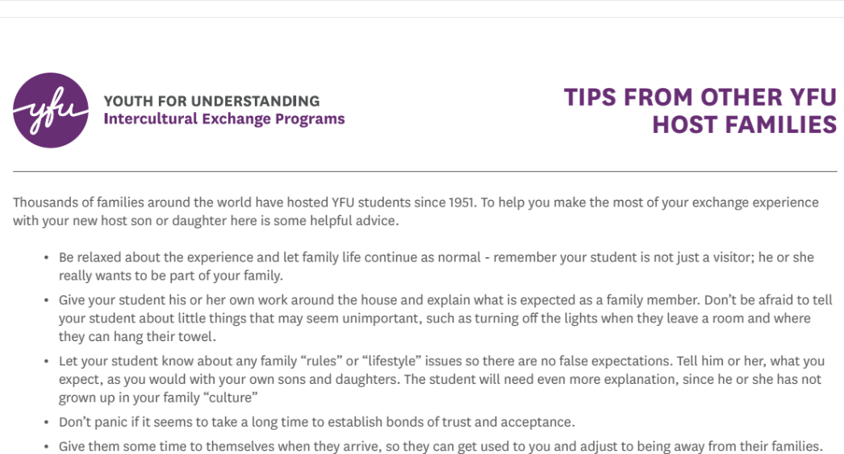
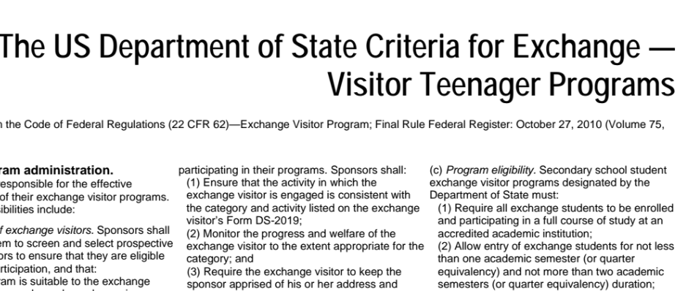
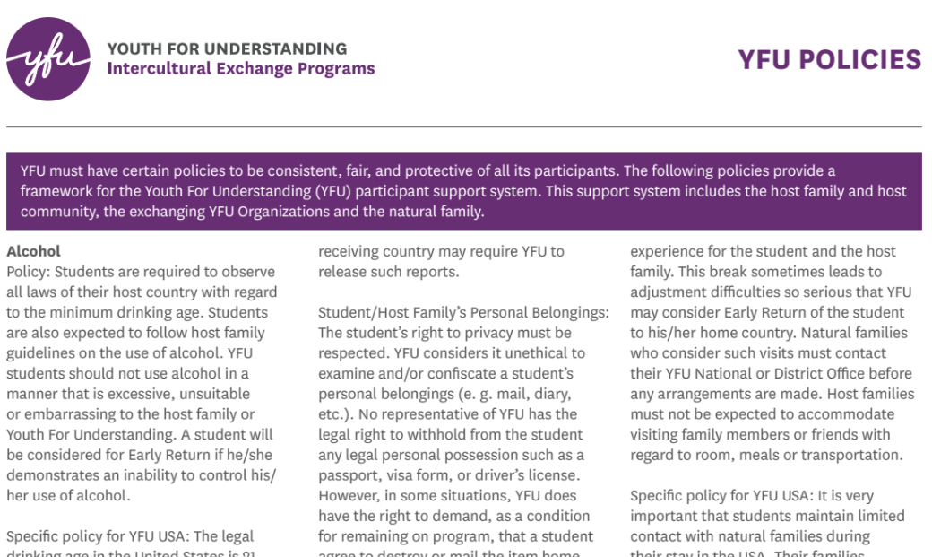
Reminder from the experts
Create a packet for the family
Tips for Host Families
Host Family Agreement
YFU Policies
Department of State Criteria For Exchange
Notes:
If possible, prepare a small packet for the family so that they have additional readings that they can review. Some FDs will send this to you via email.
The family probably has already e-signed the Host Family Agreement as part of their online application, but they may appreciate having a hard copy for reference. Note: YFU requires the one or two adult parents listed on the host family application to READ and sign the host family agreement.
Student Policies and Procedures - this is printed in the Host Family Handbook, but it can be helpful to review some important points. Families will receive the Handbook after placement is finalized.
Tips from Other YFU HFs – This is a handout and can be left with the host family for reference.
All of these papers and the Host Family Handbook can be accessed by volunteers via my.yfu.org home page or in the Volunteer Lounge under Host Family. (Click Lounge in blue bar on home page, click Volunteer Lounge. Host Family resources are listed on the left.)
There is a link to the mailed packet and other materials under Resources for the host families via the Host Family account.
This is what the forms look like. They should go into the packet that you bring with you to the interview

Slide 15
3 KEY STAGES for a successful host family interview
Schedule the interview
Prepare
Gather YFU interview tools
Before the Interview
Know your responsibilities & obtain necessary information
Be attentive in order to submit a meaningful report
At the Interview
Submitting the Forms
Submit the HF interview report
Compliant forms maintain YFU integrity
Notes:
Recap the first part of the training:
We just talked about several steps that you should do before the interview.
Ask participants to provide some examples of some of the elements discussed- encourage them to think about the three steps: schedule the interview, prepare, and gather tools.
Direct attention to the next stage- at the interview. Tell the participants that they will now take a deep dive on best practices for interviewing and will also look at some warning indicators.

Slide 16
Know your responsibilities & obtain the necessary information
Be professional and be positive about YFU
Listen closely & ask follow-up questions
Take notes in order to complete the report
Be cognizant of your own personal preferences- safety and security is the goal
Notes:
Ask participants about their own definition of profession and positive.
Fill in gaps with ideas about being on time, communicating if one is stuck in traffic, “googling” the location in advance so you don’t get lost, dress- not too casual, wearing a YFU nametag. YFU shirt if you have one.
Positive- not the time to talk about YFU challenges or some any “horror” stories about hosting
Go through the additional points:
Listen closely and ask follow up questions
While you and the family are talking, take some notes. If this feels awkward to take notes while having a conversation, explain that after the interview you need to complete an online report, so the notes will be very helpful to you.
Personal preferences- YFU values all different types of families. Keep religion, politics, and other controversial topics out of the discussion. Note that you as an interviewer, you also have bias. Check that you are not carrying your own personal bias into the interview. Safety and security is the main concern. Maintain focus on issues that intersect with safety and security.

Slide 17
3
1
Get to know
the family
Introduce yourself
2
Notes:
Ask participants to share some ideas about how to do the following three items:
Introduce self
Introduce the interview- goal of interview-
Get to know the family.
Notes for trainer:
If you arrive and someone crucial (parent or teen sibling) is missing, consider the reason for the absence.
If it is an emergency or truly unavoidable, you may decide to continue with the interview. Recognize that you will not be able to observe the true dynamics of the family.
Note that if a family member has an extended absence because of work or school, the family member needs to send an email to the interviewer which the interviewer will forward on to the FD for record keeping.
If the absence is due to failure to take the interview and family commitment seriously, it may be best to reschedule the interview.
If you don’t have a good feeling about the explanation, listen to your gut.
The interview is a chance to build a relationship with the family, so try to get to know this family as well as you can. You want them to TRUST you, especially if you will be their Area Rep. Area Rep is there for the family as well as the student.
1. Introduce yourself by briefly describing yourself and your current role as a YFU volunteer.
If HF is new to YFU- Describe your history with YFU (tell why you choose to volunteer your time to YFU)
Refer to the history of YFU: started 1951 as outreach after WWII; students from 60+ countries
Describe some of your YFU experiences (keep these short and to the point) Have you hosted before? Have you been an area representative before? Have you worked with the students and their host families? With what countries are you familiar?
2. Introduce the interview
Remind the family that the interview will take approximately 1 ½ hours to 2 hours. Explain that there needs to be plenty of time so that the family can become more familiar with YFU and ask questions.
State the purpose (to make sure the environment and atmosphere of the home and family provides a safe place for a prospective student).
Explain that after your discussion/interview, you will need a tour of the house
3. Get to know your family- During the interview, we want the family to develop trust with YFU; use icebreaker questions to begin to build rapport and TRUST. Keep it fun and especially get children involved in the conversation. Also think about what was learned when reviewing the application. Ask questions based on the application responses.
Have you hosted before? When? Where was the student from?
Which organization? (If not YFU, why did you change to YFU?)
Did that experience go well? Why or why not?
Little Suzie, are you excited about having an older sibling- what kinds of things will you do together?
How did you choose YFU?
Joey, plays soccer- how fun! How has the season been going?

Slide 18
Conduct Your Interview
Set a positive, warm tone & use open-ended questions
Encourage & validate concerns
Use the report questions to guide your conversation
Optional: use additional YFU questions to spark conversations
Use opportunities to set realistic expectations
Students hope to be family members,
not guests or visitors.
Notes:
Notes for trainer:
Set the tone
I will help you understand what it’s like to be a host family.
I want to be sure that we have addressed your questions and concerns.
If you have not already done so, clarify HF responsibilities before you go to interview questions: financial, guidance, transportation, orientations, monthly contacts.
Open-ended questions (more examples on the following slide) – also summarize & rephrase & ask follow-up questions
Why do you want to host?
How do you think this additional family member will change your household?
What rules and expectations do you have for household members (including unspoken rules)?
What privileges and responsibilities do household members have?
Encourage realistic expectations and validate concerns.
You will be getting a teen who may or may not be what you envision from the student application.
Conduct the interview. Go through the information below.
Before you start with interview questions, clarify HF responsibilities [shown in slide 10 and 11]: financial (including school lunches), guidance, reasonable effort to provide transportation. orientations (4, including the host family pre- arrival), monthly contacts (at minimum)
Seek health care as needed. Remember that HFs should not pay student bills. Contact YFU if there is a problem.
Use the interview report as a guide for your conversation. The report requires the you make a judgement call for each questions. Knowing the reporting questions well and using these to help guide the conversation is a good strategy.
Throughout the interview, prepare the family to have realistic expectations. Successful host families should be interested in teenagers/ international students and be familiar with what life with a teenager is like
Many people have preconceived ideas that children are all the same and/or are the same as their written profiles.
Not true. All children are individuals. The only thing they have in common is that they are teenagers.
In fact, the students complete their applications up to a year before placement; they may have changed and may have different interests from those mentioned in the application. Be flexible and plan to love the student who joins your family.
Anecdote: (You can also use one of your own if it is on point.) Recently, a family wanted to host a Chinese exchange student to give their 2 adopted Chinese daughters exposure to their culture. However, when the exchange student acted differently than their daughters, they didn’t understand why and got upset. The host parents thought they knew everything about Chinese culture, but didn’t. They also did not take into account the age difference (their girls were 9 and 11, the exchange student was 15.) In addition, they failed to consider that their adopted daughters were raised in the U.S. with our cultural ideals. Their exchange daughter was raised in China by Chinese parents.
During the interview you can return to the importance of having the student become a family member rather than a visitor. Explain the difference and explain that it matters because people eventually resent visitors vs. a participating family member. It creates jealousy and resentment leading to other problems. Perhaps introduce the Visiting to Belonging progression.
We hope you will receive student as a member of your family. Don’t treat them like guests.

Slide 19
Sample questions to SPARK conversations
Reminder from the experts
Do you have an evening routine that you would expect your student to adopt?
How would you feel about having your student on a school sports team that has a 5-6 day/week commitment?
What do you like to talk about during dinner? Would you want a student who is interested in current events?
Would you allow/encourage a student with different political or religious or social opinions?
What do you hope to learn from your student?
How does your family express affection?
How do you spend your weekends? Would you have plans for your student on the weekends or are weekends free time for student to schedule outside the home?
When you think of your student and his/her activities, how busy or not busy do you hope s/he will be?
Notes:
Ask participants to take a look at the questions on the slide. Are there any that they really like? Do they have any additions to the list.
Consider as open-ended questions:
Do you have an evening routine that you would expect your student to adopt?
How would you feel about having your student on a school sports team that has a 5-6 day/week commitment?
What do you like to talk about during dinner? Would you want a student who is interested in current events?
Would you allow/encourage a student with different political or religious or social opinions?
What do you hope to learn from your student?
How does your family express affection?
How do you spend your weekends? Would you have plans for your student on the weekends or are weekends free time for std to schedule outside the home?
When you think of your student and his/her activities, how busy or not busy do you hope s/he will be?
Would you like for her to join activities and be busy at school several days a week?
Would you like for her to go out with friends to school events and on weekends?
Would you be concerned if she spent a lot of time at home?

Slide 20
Is the family a good fit for hosting? Warning Indicators may fall into several categories: 1. Family Relationships and Communication 2. Motivation for Hosting 3. Community/School Connection 4. Cross-Cultural Awareness 5. Organizational Commitment 6. Previous Hosting Problems 7. Safety Issues Within the Home Conditionally recommend*
Notes:
Ask participants for examples of warning indicators represented by each category.
Trainer Notes:
Disrespect; unstable marriage; age-inappropriate behavior; inflexible; no sense of humor
Unrealistic expectations; family members not in agreement
Problems with the school; isolated geographically; unable to provide transportation; inflexible regarding extreme religious or political views which they expect student to share; financial hardship
Not interested in other cultures; intolerant of different ways of doing things (some cultures want independence)
Doesn’t see value of YFU guidelines; hesitant to commit to attending ½ day orientations; hard to reach to schedule the interview
Negative hosting experience; previously not qualified to host
7. Is there anything in the home that may be a safety risk?
Note to trainer- the information below is additional information for your use. It is not necessary to go thru all of these details, however if participants have questions use the talking points below. It is necessary that if the interviewer sees a potential safety hazard, this is included in the report.
Possible scenario- fire arms. Families can own guns and host. However, families must follow safety precautions and be responsible gun owners. If, for example, a gun (or other dangerous object, such as knife) is left sitting out (not locked up) in the living room during the interview, this should be noted in the report and the volunteer should ask the family about this. “I notice your handgun on the table. What are your normal safety precautions? Tell me what it means to be a responsible gun owner to you.” The volunteer should also explain that there are cultural differences related to guns/weapons. Most students have never seen a gun and this could be alarming to them. The family will need to think about how they can talk with the student about gun safety in their home AND the volunteer should ask the family questions (without judgement) on the safety precautions they follow. The volunteer should note their own assessment of household’s approach to gun safety in the report and clearly note that a gun was not locked up. This is a good example of a time to use the conditionally recommend and be sure to tell the FD so that additional conversations can occur.
Other safety issues within the home could be: unsanitary living arrangements - for example cat litterbox is located within close proximity to food preparation (on the kitchen counter); drugs or drug paraphernalia (cannabis is legal in many states) is not properly stored. Take note of these concerns and any other concerns that could potentially be harmful to a student.

Slide 21
Observe and think about…
Anything unusual about the answers? How do you feel about the responses? The tone? Is there anything unsafe about this home?
Are any family members uncomfortable? Does one person do all the talking?
Do family members have incompatible levels of commitment or expectations?
How body language and facial expressions conflict or support answers?
Am I bothered by a response due to my own preferences*?
Will you recommend enthusiastically or with reservations?
If you have concerns, note down specific quotes/conversation that triggered these concerns.
Notes:
If you have time, use this slide for discussion with participants.
While you are encouraging discussion, you are also observing body language as well as verbal responses.
Pay attention to body language:
Are they comfortable?
Do they make eye contact?
Does one individual supply all the answers?
Do they hesitate when answering?
Do they fidget?
Do they display nervous or inappropriate laughter or responses?
Do they seem respectful of each other?
Watch for responses which would indicate or create barriers.
Be alert to whether all family members are in agreement
Note anything that makes you uncomfortable (review warning indicators list):
Family relationships/communication – is one host parent doing all the talking while the other is silent? How do the children interact with the adults? Is there respect for one another? Is any family member hostile to the hosting?
Motivation for hosting – Are they looking for a new friend for their child? Is there something very specific about the student they’ve chosen? Remind families that student change and much time has passed from when the student completed the application and when the student arrives to the US.
Anecdote: (You may use one of your own if you have a story or good example. Remember to keep it on point and short.) Recently, a family chose their exchange student because she played the flute and was in the band in her home country. They assumed the student would continue with band while she was in our country and would practice with their daughter. However, the exchange student had decided to take the year off while on exchange. The host family was upset and told her so, including telling her that they chose her because she played flute as their daughter did. This caused friction from the beginning. This expectation caused the placement to go downhill and the result was that the exchange student was moved to another residence.
Anecdote: HF chose a dancer. They valued cultural activities and were anti-sports. The student wanted to take a break from dancing and was eager to try cheerleading (an American activity). HF was furious – said they had been mislead – and would not provide transportation. Student moved to family of a fellow cheerleader.
Cross-cultural awareness – Have they thought about having another culture in their home?
Previous hosting experience – Was it successful? What happened?
Signs that an adult may be at-risk to harm a child emotionally or not give appropriate guidance – inappropriate humor, comments or topics of discussion
Condition of the house and/or yard – overly messy, dirty, cluttered…
Teen host siblings and Study Abroad alums- Try to ascertain their reasons for hosting, their flexibility, and their understanding that the year exchange is more challenging than a summer exchange. If a host sibling turns against a student, it is hard to turn them back, and this can be the reason for a student move.

Slide 22
Be mindful of personal preferences, the focus is safety
Lifestyle choices
religious, non-traditional family, eating habits, pets (lots of pets)
Condition of the house
Messy is ok, “dirty” could be a concern- if it impacts health
example- children and toys,
backyard and lawn care,
basements and storage spaces
Notes:
Ask participants what they think these bullet points are about.
Emphasize that the purpose of the interview is for YFU to evaluate if the home is a safe place for a student. Volunteers need to be very careful of their own bias and preferences.
Trainer Notes:
Many people have bias that they are not aware of related to religion, lifestyle choices, and cleanliness.
Do not “not recommend” a family simply because they make different choices than you. We see this often as it relates to the condition of the house.
Story- while maybe you as an interviewer are very neat, a family with three boys under age of seven may have a home full of toys and chaos! They could be a great family, don’t “write them off” because their house is a little messy.
Balance approach- stay focused on health and safety.

Slide 23
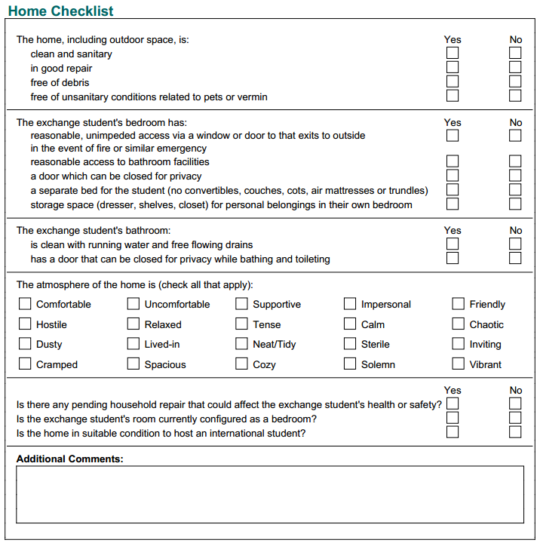
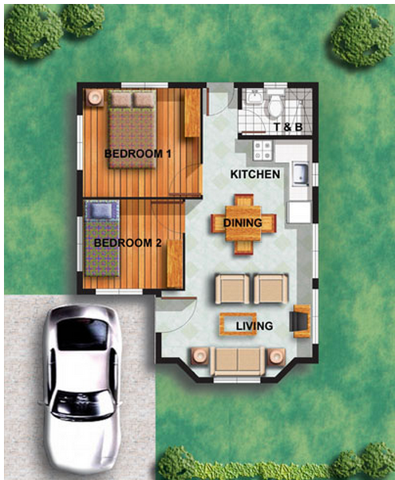
SEE visit also uses Home Checklist
Notes:
Trainer notes:
Take a tour of the entire house so that you can answer questions on the interview form/s. It may be necessary to remind the family about the reason that the questions or the inspection seem intrusive. Explain that student health and safety is a priority. Be alert to family responses if certain questions make them uncomfortable.
Check for running water in the bathrooms used by the exchange student and note whether the student’s bedroom has a door and window. These are questions asked on the report forms.
It may be helpful to have the Home Checklist (on page 3 of the Annual Family and Home Review ) in hand while touring the house.
Remind the family about the 2nd home visit called the SEE visit (Student Environment Evaluation) which will be required within 60 days of students arrival. This 2nd visit is a DOS requirement to confirm that the house continues to be a safe and healthy environment for the student.
Tell family that it will be another person who conducts the 60-day visit because DOS rules mandate that the two inspections can not be done by the same individual. I like to add a bit of humor by saying that DOS is checking on ME!
Tell parents that the 2nd visit will be brief and that the volunteer does not need to meet with either parents or student. The volunteer just needs someone to guide through the house.

Slide 24
Before you leave
Did all family members participate?
Are house pictures uploaded?
Host Family Agreement signed?
Application fully completed?
Describe next steps for placement
** recommending / not recommending
Leave your contact information.
Say Thank You!
Notes:
Trainer notes:
Your recommendation is an important part of the host family application.
Look at the Interview Report and Annual Host Family Home Review to ensure you have covered all the required questions.
Ask for clarification or further information of anything in your notes that you don’t understand or that you feel needs more information.
From your preparation, you should be knowledgeable about where they are in the application process. Remind them about anything that is missing.
**Mention that approval to host a student is a process and the interview is just one step in that process. You, as a volunteer interviewer, are not able to determine if they will be approved to host. That is enough information for families that you will not be recommending.
**If you will be recommending the family, you can tell them that you think they would be a good HF. (We want to encourage good families.) If they ask about the next steps and you have reservations about the recommendation, explain that you will be submitting the report and so
Describe the next steps in the process.
Application approval (by staff)
Student selection differs in different areas. The interviewer can contact field director about “holds” and the selection process.
School acceptance
Family may contact the student once placement is permanent.
Family receives student information from the YFU National office
Pre-arrival orientation before student arrives (usually in July/August) are required for all host families, new and returning.
All orientations (usually September/October, January and April/May) have a parent session component.
See if they have any other questions.
Leave your business card, contact numbers for district office and/or field director. (If you do not have business cards, write the contact information on a 3 x 5 index card ahead of time).
Always thank people for their time and consideration.

Slide 25
3 KEY STAGES for a successful host family interview
Schedule the interview
Prepare
Gather YFU interview tools
Before the Interview
Know your responsibilities & obtain necessary information
Be attentive in order to submit a meaningful report
At the Interview
Submit the HF interview report
Compliant forms maintain YFU integrity
Submitting the Forms
Notes:
.
Direct attention to the last stage- completing the forms. Tell the participants that they will now take a deep dive on best practices for interviewing , including some active listening tips.

Slide 26
Notes:
Click through the next slides quickly, then do an example with the Sandra Lynn Holmberg application bring it up live so participants can see this.

Slide 27
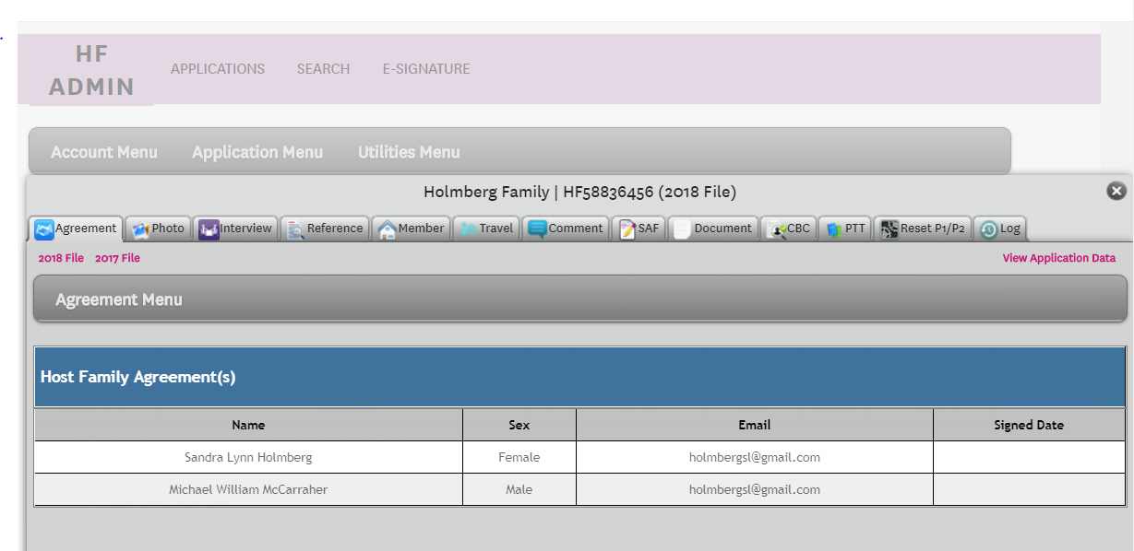
Notes:
Click on Interview to show Interview Menu which will give drop-down options.
Select from the options.

Slide 28
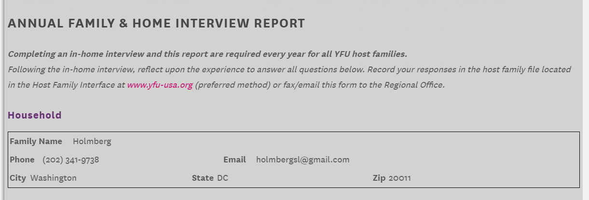
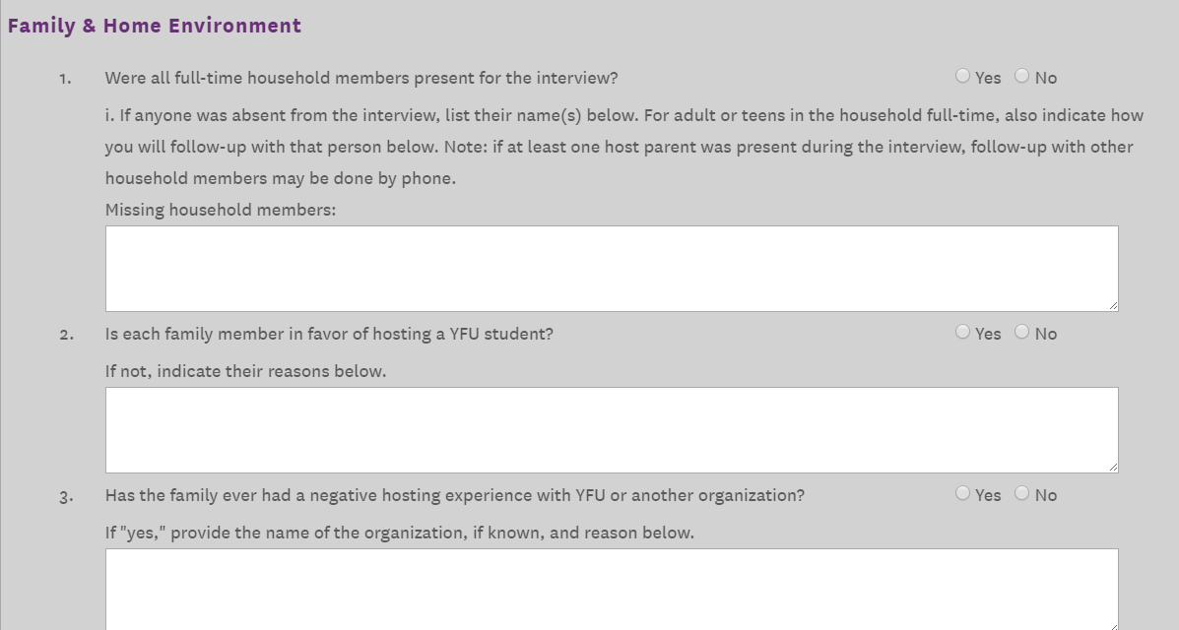
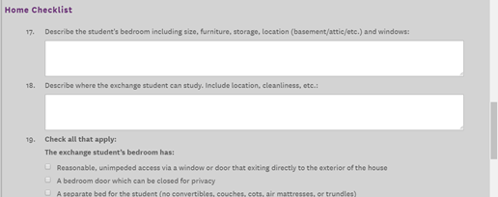
Household Information
Home Environment
Home Checklist
Recommendation
Save & Sign

Slide 29
Training Objectives:
Identify the three stages of the HF interview and explain the key responsibilities for each stage
Find the interviewing resources
Follow DOS and YFU regulations during the interview
Use successful interviewing techniques
Analyze factors when completing interview forms and making a recommendation
Complete and submit the interview form
Notes:
Ask a participant to read the objectives, with each objective provide some examples or additional context to make the objective come to life, use the phrase “Volunteers will be able to”
Ask if anyone has any questions about the objectives.
Addition idea/reminder to discuss: It is imperative that we do whatever we can to prepare our host families and guide them toward realistic expectations for hosting. The host family interview is one of the earliest and best opportunities to begin a relationship with the host family. A good host family interview helps not only with the placement and support of our students; it also helps set realistic host family expectations and encourages host family development and positive change toward incorporating the student as a member of the family.

