Slide 1
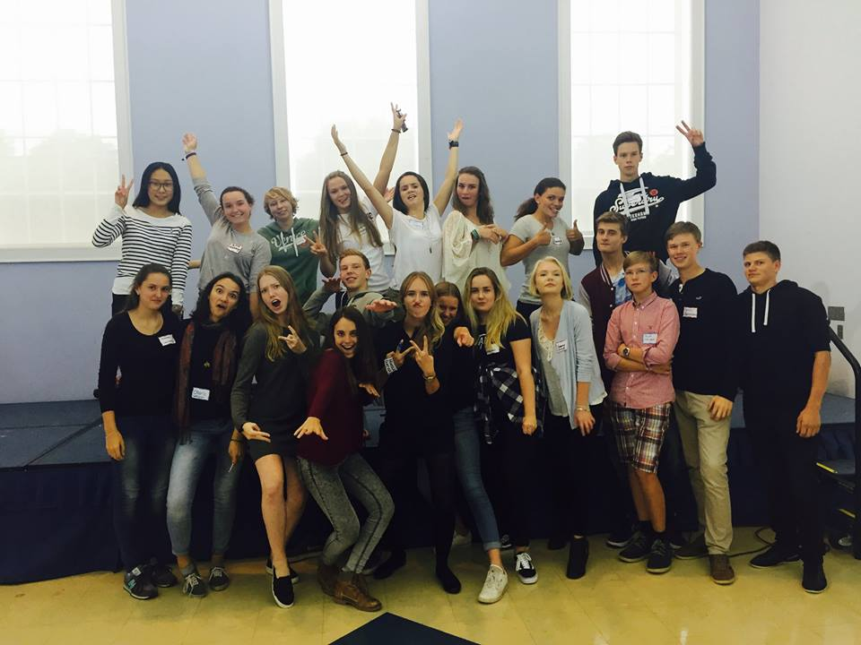
Overview of Orientations
Notes:
Welcome participants to the session, introduce yourself.
This session is about an hour, depending on if all the activities are carried out.

Slide 2
Session Objectives
After this training session, volunteers will be able to:
Link key orientation themes to the exchange experience
Carry out priority tasks related to YFU orientations
Review best practices for facilitation
Notes:
Ask a participant to read the objectives. Elaborate on the objectives and provide some insight using personal experiences.

Slide 3
Culture Adaptation
My Culture
The “New” Culture
YFU Rules
YFU Support
YFU Community
Student Safety and Well-Being
Orientation themes:
Notes:
Ask participants: What kinds of themes are included in all orientations?
Review the theme from visiting to belonging- YFU goal is that while students may initially feel like visitors in the home, over time the student will feel like they “belong” in the home with their host family.
Explain the relevance of this theme and how the orientations are meant to guide students and families through their experiences.
Ask participants to note the different orientations and when these occur during the exchange. Ask them to share some of their ideas regarding the main goals of the different orientations and how these correspond to the student’s adjustment.

Slide 4
YFU Orientations – Why?
Notes:
Explain why orientations are so important to our mission and our compliance.
DOS allows our students to get visas, we have to follow their rules. DoS audits YFU for attendance at orientations.
CSIET accredits exchange programs, Many schools won’t accept students unless their program is on the CSIET lists. To be accredited, programs have to follow their guidelines- which includes orientations.
YFU has the most extensive list of expectations regarding orientations. The YFU global network has standards in place that relate to orientations.
Pre-Dep, Pre-Arr, Post-Arr, Mid-Year, Re-Entry. These YFU guidelines are stated in the LOOPs- Learning Outcomes for YFU Orientation Programs (LOOP) for all orientations that are being incorporated by every YFU partner country worldwide.
Most importantly, YFU cares about our students and families. Orientations provide an opportunity to connect with students and families, check-in on how the exchange is going and provide tips for adjustment and cultural learning.

Slide 5
Small Group or Partner Activity
List the key tasks associated with organizing an orientation
Next to each task, list a tip or best practice to accomplish that task.
EXAMPLE:
invite students and families - use evite, get email addresses from FD, send evites one month in advance with an RSVP required
Notes:
Activity- in a small groups using flip chart paper, brainstorm the main tasks related to organizing an orientation and tips and best practices for accomplishing that task and/ or the timing.
For example-
Provide groups with 10 minutes to work together.
Ask groups to quickly report out and note similarities between the lists. Hang the lists on the wall. Pay special attention to the tasks that are listed as difficult.
Highlight the tips and best practices and encourage people to share more suggestions.

Slide 6
Orientation Coordinator Duties
Main responsibilities...
Ensure that the team is working together and everything gets done
Invitations and RSVPS (this can be delegated)
Scheduling the event & site selection (often done in collaboration with the FD)
Staffing (facilitators, welcome table, sign-in sheets, food prep)
Supplies/materials (also can be delegated)
Requesting materials from National Office
Additional tasks, depending on the team….
Session prep/facilitating
Social activities
Volunteer team building
Notes:
Animated slide,
Round out the discussion by going through the primary role of Coordinator. Explain that it is important that someone takes charge. In some cases this role might be assigned by the FD.
The coordinator is ultimately responsible to ensure that all tasks are completed, either by doing them personally or by delegating tasks to others.

Slide 7
Many flexible roles……
Facilitators
Logistics Roles
Primary Facilitator
reviews curriculum with team members
develops the agenda for the day
is familiar with all sessions
leads many sessions, co-leads with others
Facilitator (2-3)
Co-leads and leads sessions
reviews their assigned sessions and is prepared to lead specific activities/sessions
supports the Primary Facilitator throughout the day
Site Coordinator
Food Coordinator
Set Up and Clean Up
Volunteers can take on more than one role.
Notes:
Discuss the different roles
Emphasize that volunteers can take on more than one role. For example, one person can take on a Facilitation Role and still also help with food.
Most importantly, the Orientation Coordinator needs to ask specific people to help with specific things.

Slide 8
DELEGATE: On-line sign-up tools make it easy to get volunteer help.
SignUpGenius.com
SignUp.com
Volunteersignup.org
Notes:
If there is internet access, show participants how easy it is to use any of these tools. Explain that these tools allow you to list out your needs, the date, and the details and send to other volunteers. Volunteers can then sign-up for what they would like to do.

Slide 9
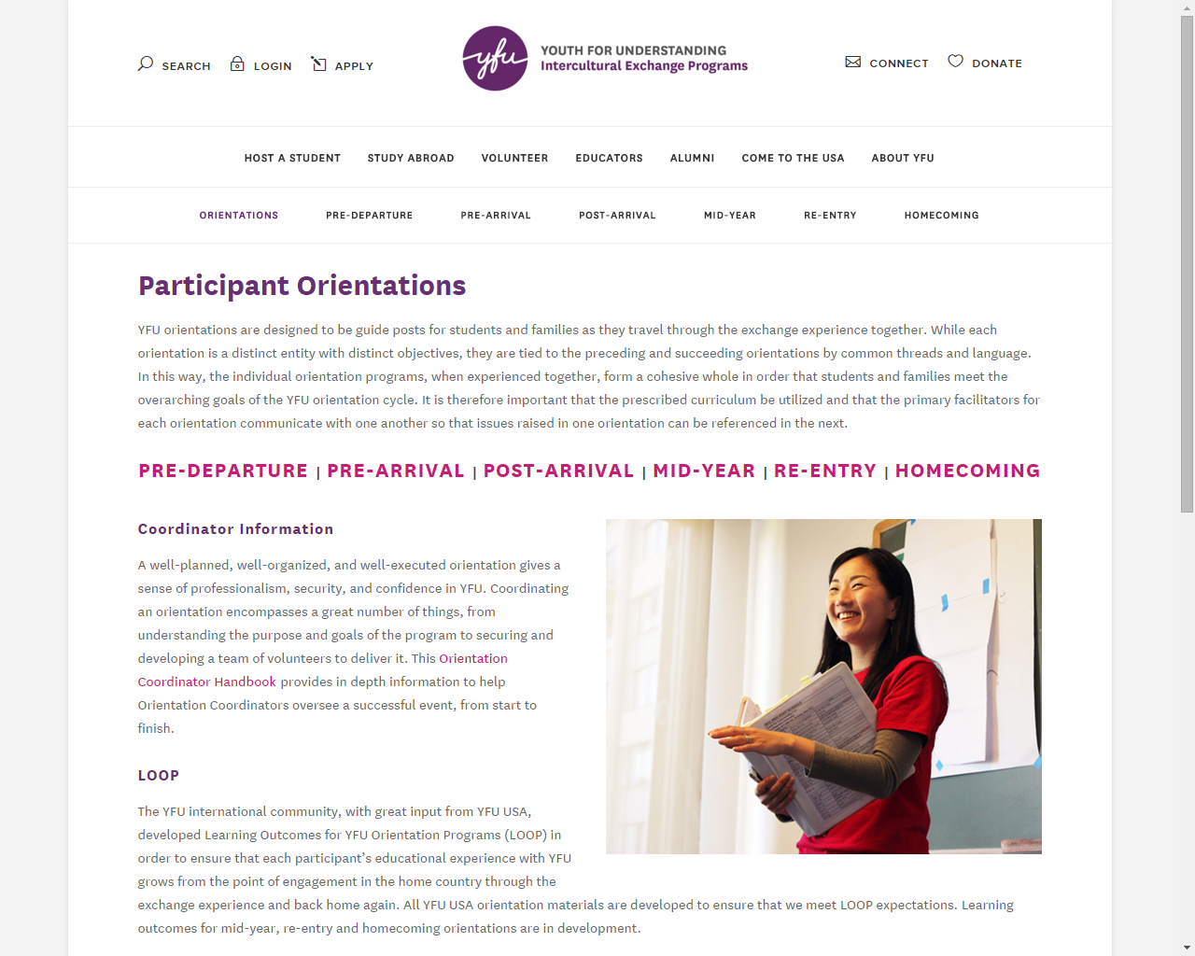
Orientations at my.yfu
http://www.yfuusa.org/orientations
Notes:
Show participants where to find materials. Note that each orientation page includes curriculum, handouts and admin forms,
SHOW
where to find the advance form (on the specific orientation webpage)
Main Orientation page showing how to find orientation curriculum materials for all YFU orientations
Note the Coordinator Handbook.

Slide 10
Orientation Budget
Tight budget
$10 per student per orientation.
$ 10 per student to cover any site fee, food, and supplies- requesting a cash advance is available through your E & T liaison
Budget does not cover social activities, budget does cover venue fees- need to find low cost/free venues
If this amount does not sufficiently cover expenses, contact your Field Director.
Notes:
Go through budget parameters
Ask for specific ideas on low cost space- libraries, churches, community buildings, banks, schools, condo meeting rooms

Slide 11
Mid-Year Orientation
Sign-In Sheet, Northland
Please submit this sheet to orientations@yfu.org, mail to the YFU office as soon as possible!
Please print in black ink or copy the student names into far left column
in advance of orientation.
Orientation
Sign-in Sheet
­
Pre-populate form with names, alphabetically.
Create separate sheets for Students,
Host Families and Volunteers.
Completed sheets must be returned to YFU immediately after the orientation.
­
Student Name (print) | SIGNATURE
Example- John Brown
Bae, Su-Hyeon
Brose, Anna
Fathurahman, Aryo
Helwich, Maya
Kabe, Chiaki
Ögard, Joonatan
Sahawneh, Arar
Sörensen, Anna
Suebthawilkul, Korntita
Tan, Xuefei
Wein, Milena
Notes:
Sign-in sheets are critical. These show participation and are used to track attendance across the nation.
They must be easy to read. It is best to pre-populate the sheet, typing student names in alphabetical order. Email to orientations@yfu.org immediately.
These documents are filed and then pulled for reports. If there is no signature, YFU is out of compliance.

Slide 12
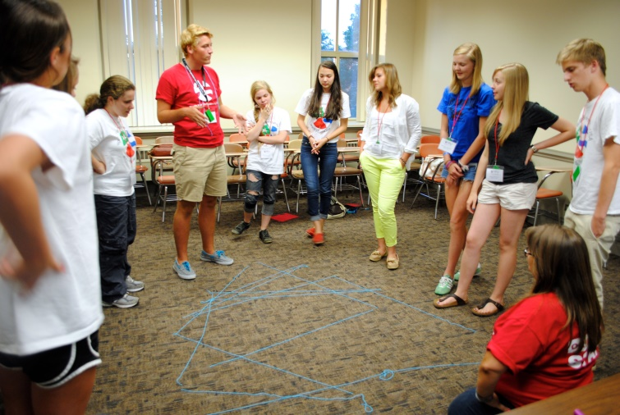
Orientation Day
Arrive an hour in advance for set-up
Ask participants to help you set-up (food, arrange chairs, clean up, etc)
Post a written agenda for the day
Begin and finish on time
5. Model desired behaviors: “Please”, “Thank you”,
being respectful, taking turns, careful listening, etc.
Check YFU’s
Orientation Coordinator Handbook
(pages 29-32) for a complete checklist of tasks to be completed before, during and after the orientation.

Slide 13
Orientation Follow-up
After returning home...
Complete and submit required documents within one week:
SIGN-IN SHEETS
COPY OF THE AGENDA
EXPENSE REPORTS
4. Orientation Reporting Form- found under Administrative Forms on each orientation page and included in mailed packet.
To Education & Training via
email: orientations@yfu.org or
mail: YFU Education & Training
641 S Street, NW Suite 200
Washington, D. C. 20001
IMPORTANT!
Very,
very
important!!
Notes:
Expense report form: https://www.dropbox.com/s/d5myt0z9mzkwg3a/2017%20Final%20Volunteer%20Expense%20Report.xlsx?dl=0

Slide 14
Orientation Follow-up
After returning home:
Reflect and make notes regarding things to remember for next time
Debrief with orientation staff
Send thank you notes to volunteers and venue
Contact SSM in writing
Secure follow-up dates for site, if appropriate.

Slide 15
Orientation Follow-up
Prepare for make-up orientation (face-to-face or webinar) for those who did not attend.
BEST OPTION: Meet face-to-face with one or more students or host family members, using the Small Group-Home Based PowerPoint presentation available on my.yfu.
Submit a copy of a sign-in sheet or a completed Individual Orientation Reporting Form, found on orientation page on my.yfu.org, following the directions on the form.
A WEBINAR can be scheduled for those who missed the live orientation, with the help of E & T, if required.
Have individuals who missed the orientation participate in one of the webinars being scheduled by E&T.
Notes:
Possible questions: Where does one find the Individual Orientation reporting form for the Orientations? The link is on every Orientation page on my.yfu.org….Pre Arrival, Post Arrival, Mid Year and Re Entry.
Are make-ups necessary for Mid-Year and Re-Entry? Makeups are necessary per YFU standards.

Slide 16
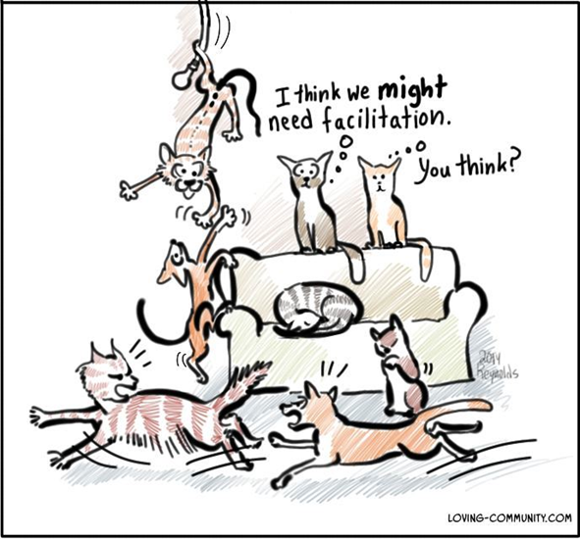
Facilitation
Notes:
Let’s move on to the last objective of this session- facilitation and best practices

Slide 17
The nuts and bolts of what they learn is OVERSHADOWED by how we make them feel. This impacts motivation.
Notes:
Ask someone to read- why is this relevant regarding facilitation with students and families?

Slide 18
Setting the tone: List ideas and actions that a facilitator can do to set the right tone and make students feel welcome and excited to be at the orientation.
“The nuts and bolts of what they learn is OVERSHADOWED by how we make them feel. This impacts motivation.”
Notes:
Ask participants to do this independently for just 3 minutes, then click to the next slide to show them think-pair-share

Slide 19
Think- Pair- Share
1. Think on your own:
What resonates with you?
2. Pair up with someone
and discuss your ideas
3. Share with the group
Notes:
Share the Think-Pair-Share strategy to engage participants. Explain that they just completed the independent think, next – pair with a partner and share your ideas.
Let partners share for 3 minutes.
Then ask teams to share- briefly.

Slide 20
Tips for Setting the Tone
Learn and use students’ names to build relationships.
Listen closely and validate participation with sincere follow-up, “Great idea, I have never thought about it like that.”
Use open-ended questions to encourage students to share.
Stay neutral, don’t judge; accept all responses. Clarify misconceptions using positive language.
Keep energy high, use physical games; get students out of their chairs.
Orientations are fun and active; NOT lectures or classroom-style learning.
Icebreakers Brain teasers & Puzzles and Riddles
Best Practices
Notes:
Show the slide and ask participants to take a look for a few minutes. Ask participants to share which of these resonates with them and why.
Remind the groups that the orientations are supposed to be fun for the students, if students seem bored, that means they need more engagement from the facilitators.
Click on the links to share the additional resources.
Energizers: https://www.slideshare.net/vickthorr/100-energizers
Brain teasers: https://www.slideshare.net/anupriyagv/ice-breaker-brain-teasers
Puzzles/riddles: https://www.slideshare.net/ohteikbin/10-creative-thinking-puzzles-presentation

Slide 21
Additional Tips for Facilitation with Students and Families
Discussion-based, participants do most talking
Facilitator asks open-ended questions to spark conversation and guide learning
Participants learn from one another by sharing experiences
All views are “accepted” but correct “misinformation”
Talk time: 70% student / 30% facilitator
Notes:
Highlight these additional best practices- as needed explain talk time and the goal of participants sharing and learning from one another, rather than the facilitator dominating the conversation.

Slide 22
Wrap Up:
Link key orientation themes to the exchange experience
Carry out priority tasks related to YFU orientations
Review best practices for facilitation
Notes:
Ask participants to provide examples of ideas they learned relating to each objective.

