Slide 1
ADD LOCATION Volunteer Training
Date:
Trainers:
Notes:
Make sure you complete this template with this opening slide to include the location, date and Trainers.
This welcome can be quick- 20 minutes or longer (45 min) depending on group size and time allotted for building trust and ice-breakers. The KWL chart (slide 5) is a critical part of the welcome in order to pre-assess the group, and validate all the experience in the room.

Slide 2
Goals for the day:
1. Recognize and thank volunteers for their outstanding efforts and celebrate accomplishments
Provide volunteers with information to carry out activities in critical YFU programming areas:
ADD technical area
ADD technical area
Notes:
Introduce the main goals for the day- these are not session objectives, but rather the picture of the day- which includes YFU thanking volunteers.
ADD the technical areas that will be the main focus- some examples:
Supporting students and families while meeting YFU standards
Strengthening and growing the volunteer community
Supporting students and families through challenges
Recruiting SA students and host families for international students

Slide 3
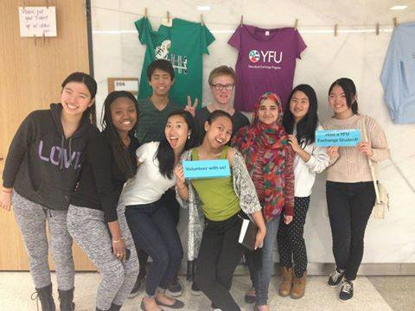
Volunteers and Host Families are what make YFU special!
Notes:
Let’s do introductions:
Icebreaker, name game, activity to connect with participants and build trust!

Slide 4
Today’s sessions Add session names
Notes:
Add the session names. This is also a good time to go over the agenda- either added on this slide and/or posted in the room.

Slide 5
Quick Warm Up:
Form teams of two or three people
Together complete “K & W” of the K-W-L chart
K (we already KNOW) | W (WANT to know) | L (what we learned)
 |  | Leave blank for now
Notes:
This is a called a KWL chart.
Looking back at the names of the sessions (bring slide 4 back up), talk with your partner about what you already know about these topics and what you want to know (W). Leave the L blank
Provide participants minutes to talk, then share out. Take notes of who has strengths in certain areas and what areas people have misinformation. Validate peoples’ experiences!

Slide 6
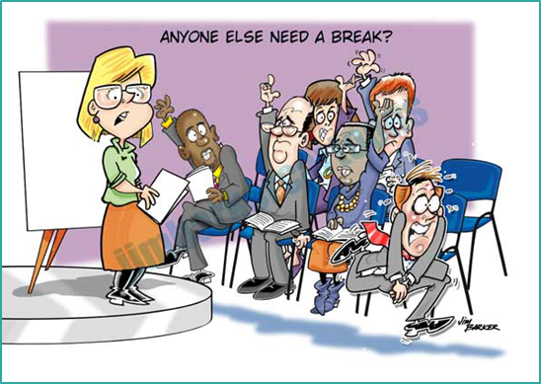
Additional Logistics & Sign-in Sheet Reminder!
Notes:
Go over where the bathrooms are located and any information about the site. Look over the sign-in sheet and make sure all participants have signed in.

